Slide 1


Adjustment of orbital elements of Galileo satellite arcs with simulated VLBI observations
Wolf H.¹, Böhm J.¹, Hugentobler U.², Nothnagel A.¹
¹TU Wien, Department of Geodesy and Geoinformation
²TU München, Institute for Astronomical and Physical Geodesy

Slide 2
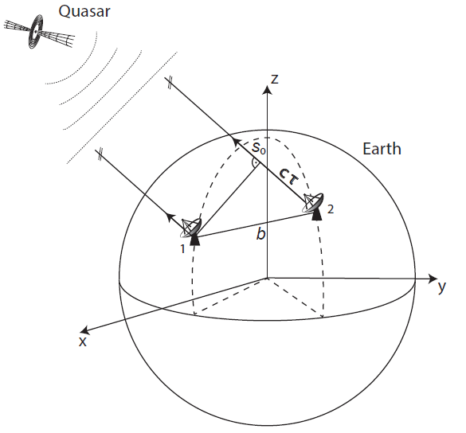

VLBI Principle
Very Long Baseline Interferometry (VLBI) measures the time difference τ between the arrivals of the radio signal from quasars at different telescopes
VLBI essential for
    International Terrestrial Reference Frame
    International Celestial Reference Frame
    Earth orientation parameters
$τ=− \frac{b ∙ s_{0}}{c}=t_{2}−t_{1}$
(Gruber, 2022)

Slide 3
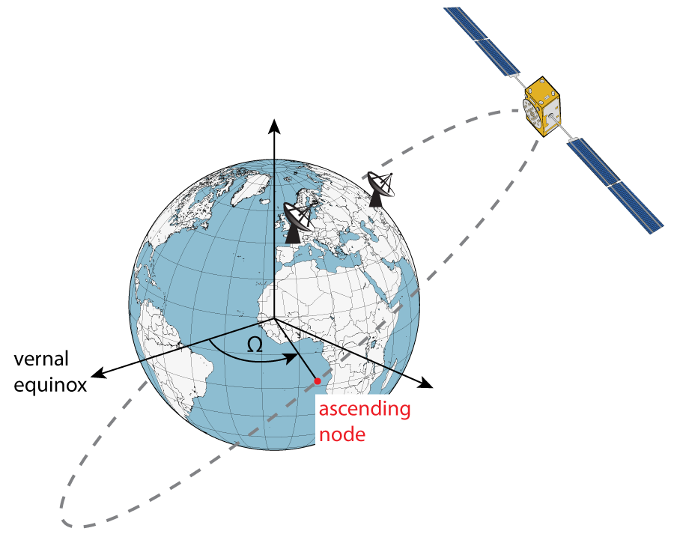
Why observing satellites with VLBI?
satellite techniques alone don’t allow to distinguish between a rotation of orbital plane and the rotation of the Earth (UT1-UTC)
    i.e., due to errors in solar radiation pressure modelling accumulated Length-of-Day (LoD) values from GNSS drift at the level of 20 μs/day (Zajdel et al., 2020)
VLBI observations to satellites enable the detection of systematic differences between the techniques

Slide 4
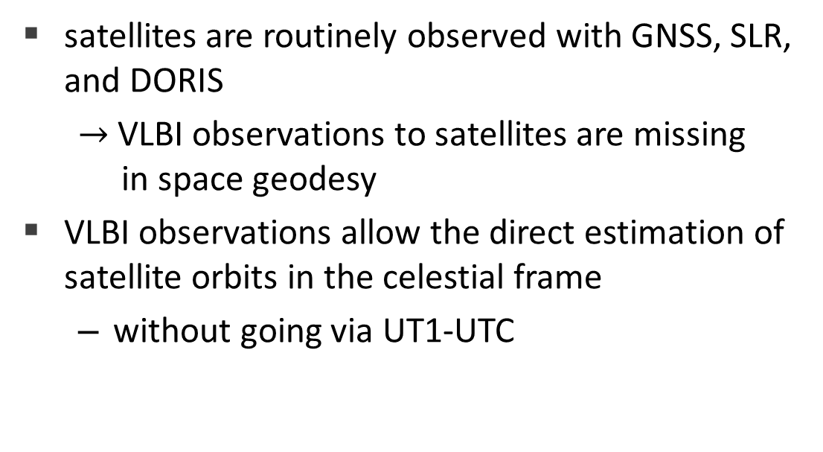
Why observing satellites with VLBI?
satellites are routinely observed with GNSS, SLR, and DORIS
  $→$VLBI observations to satellites are missing in space geodesy
VLBI observations allow the direct estimation of satellite orbits in the celestial frame
  without going via UT1-UTC
VLBI
Orbit in CRF
UT1-UTC

Slide 5
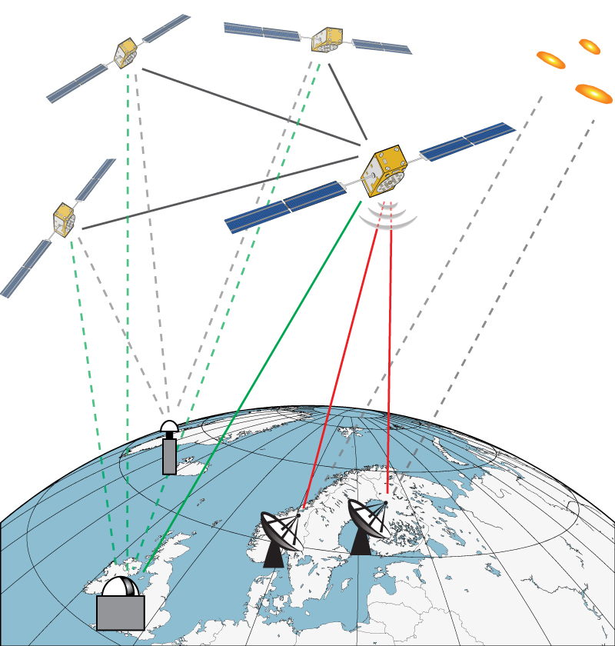
Why observing satellites with VLBI?
realising ties on-board of a satellite
high-precision tying of different space geodetic techniques
improvement of the terrestrial reference frame
  errors in local ties on the ground are limiting factor for the accuracy of the terrestrial reference frame

Slide 6

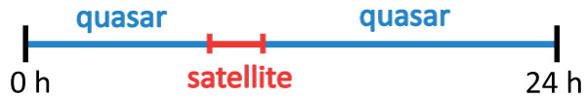

Estimation of Orbital Elements
schedules
creating schedules including quasar and satellite observations
  satellite scans with 10 seconds duration every 40 seconds
  remaining part of schedule is filled with quasar scans
simulations
1000 simulations with
  tropospheric turbulence
  clock errors
  50 ps white noise for satellite scans
analysis
estimation of piecewise linear offsets from a-priori orbit for Ω
  quasars and stations are fixed
  repeatabilities

Slide 7

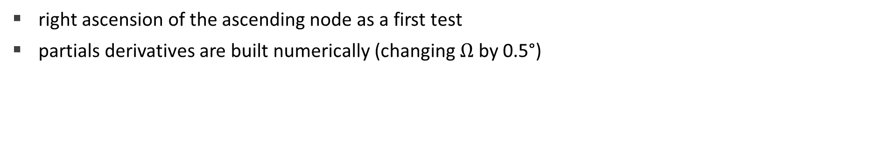
Estimation of Orbital Elements
right ascension of the ascending node as a first test
  partials derivatives are built numerically (changing $Ω$ by 0.5°)

Slide 8
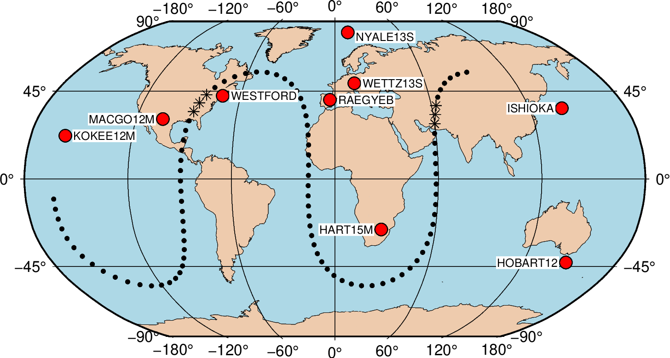
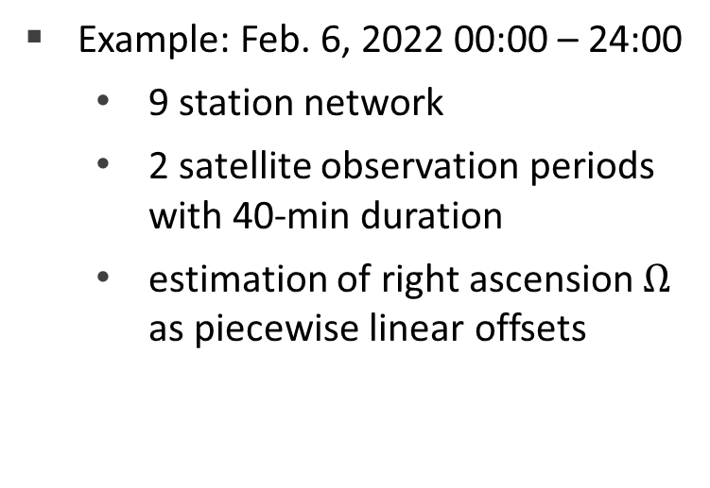
Estimation of Orbital Elements
Example: Feb. 6, 2022 00:00 – 24:00
    9 station network
    2 satellite observation periods with 40-min duration
    estimation of right ascension $Ω$ as piecewise linear offsets

Slide 9
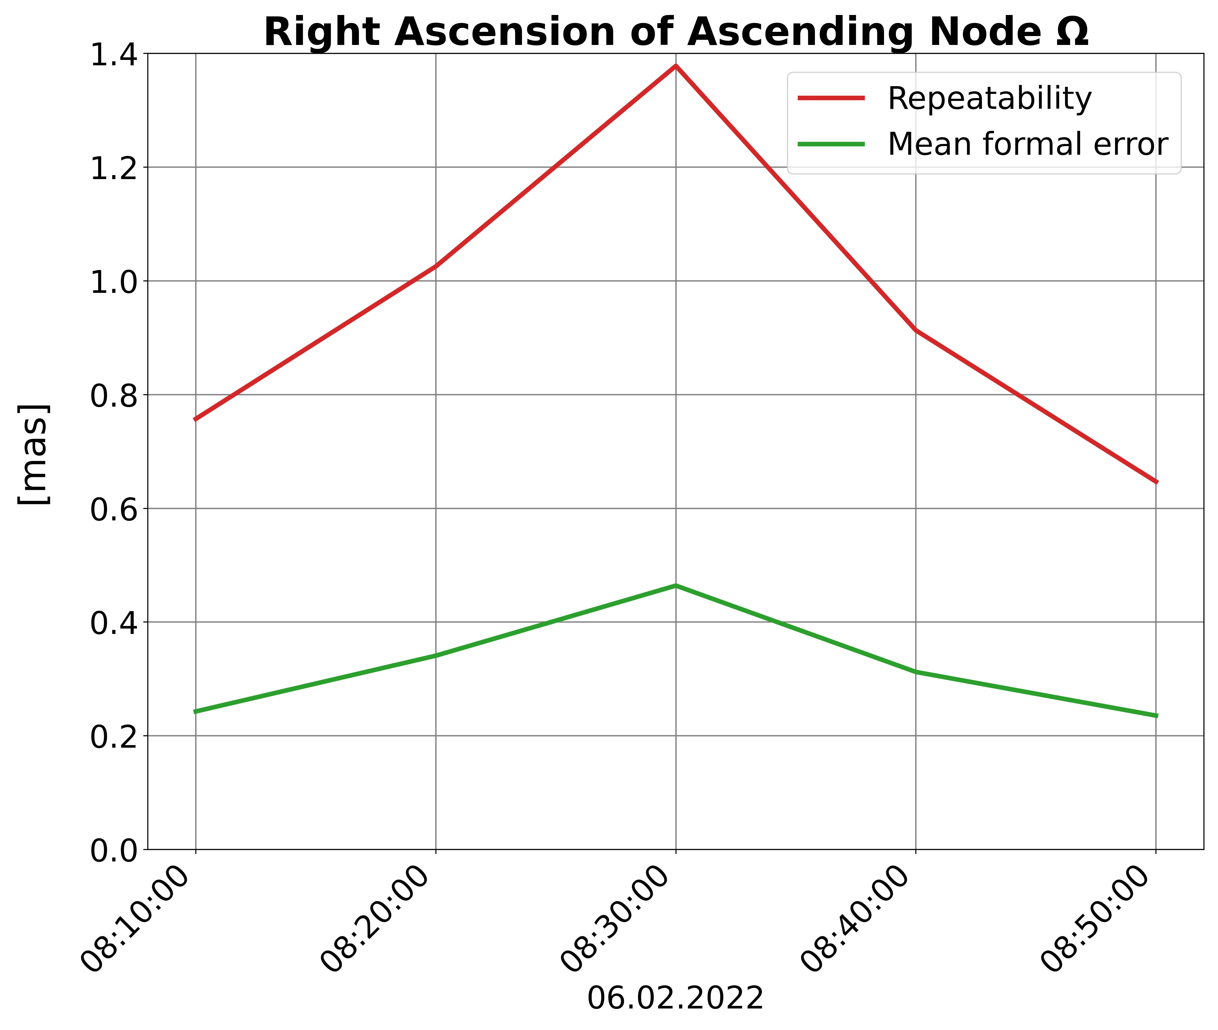
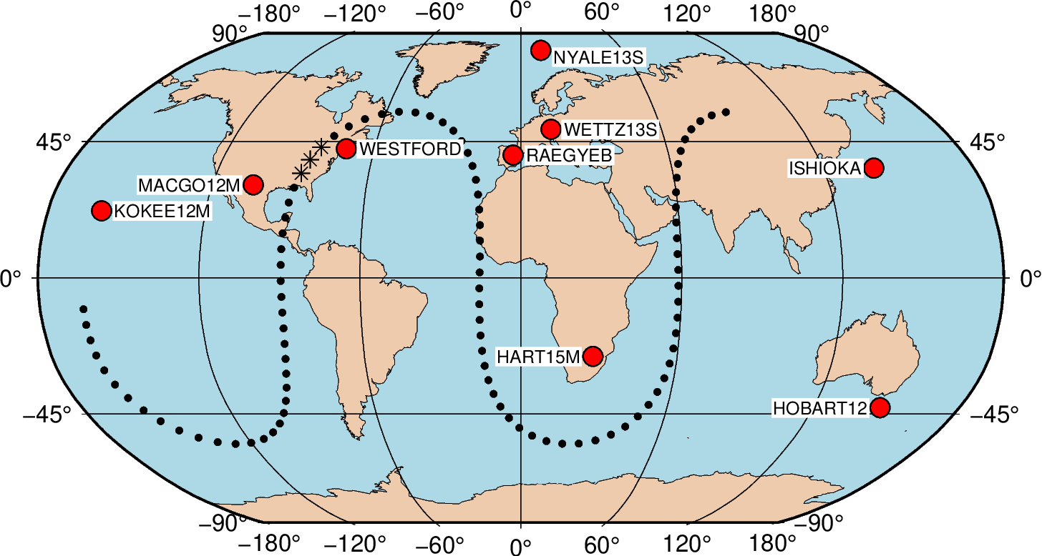
Estimation of Orbital Elements
satellite observations from 08:10 – 08:50 with 6 stations

Slide 10
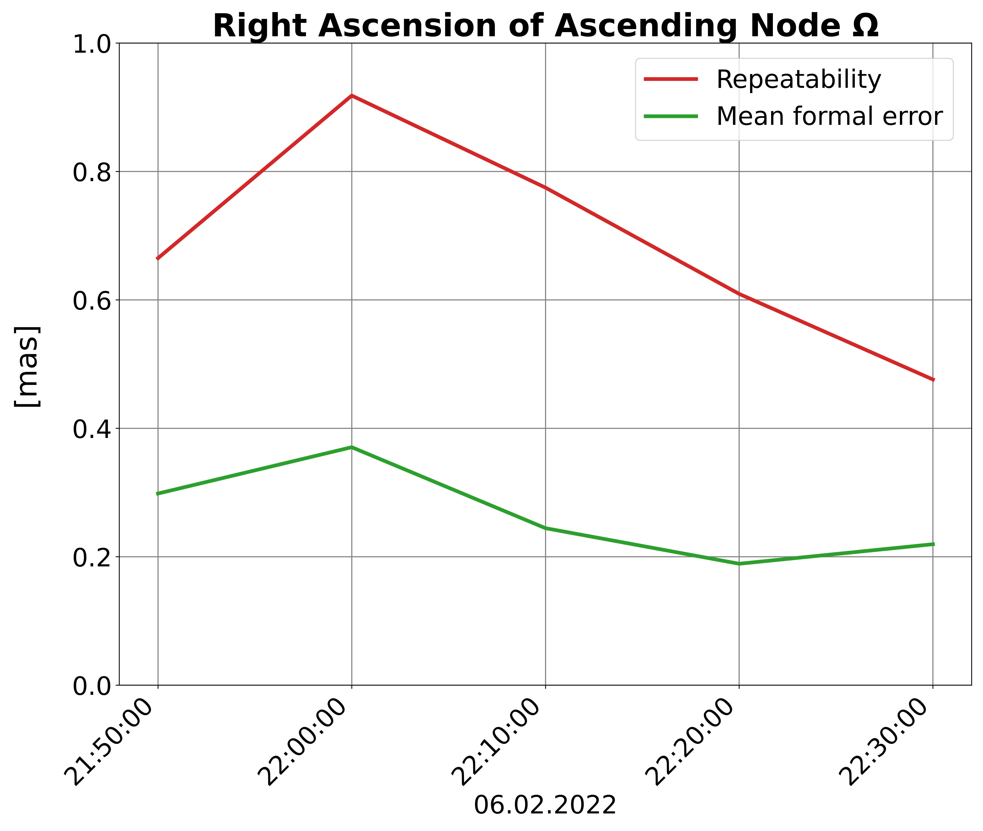
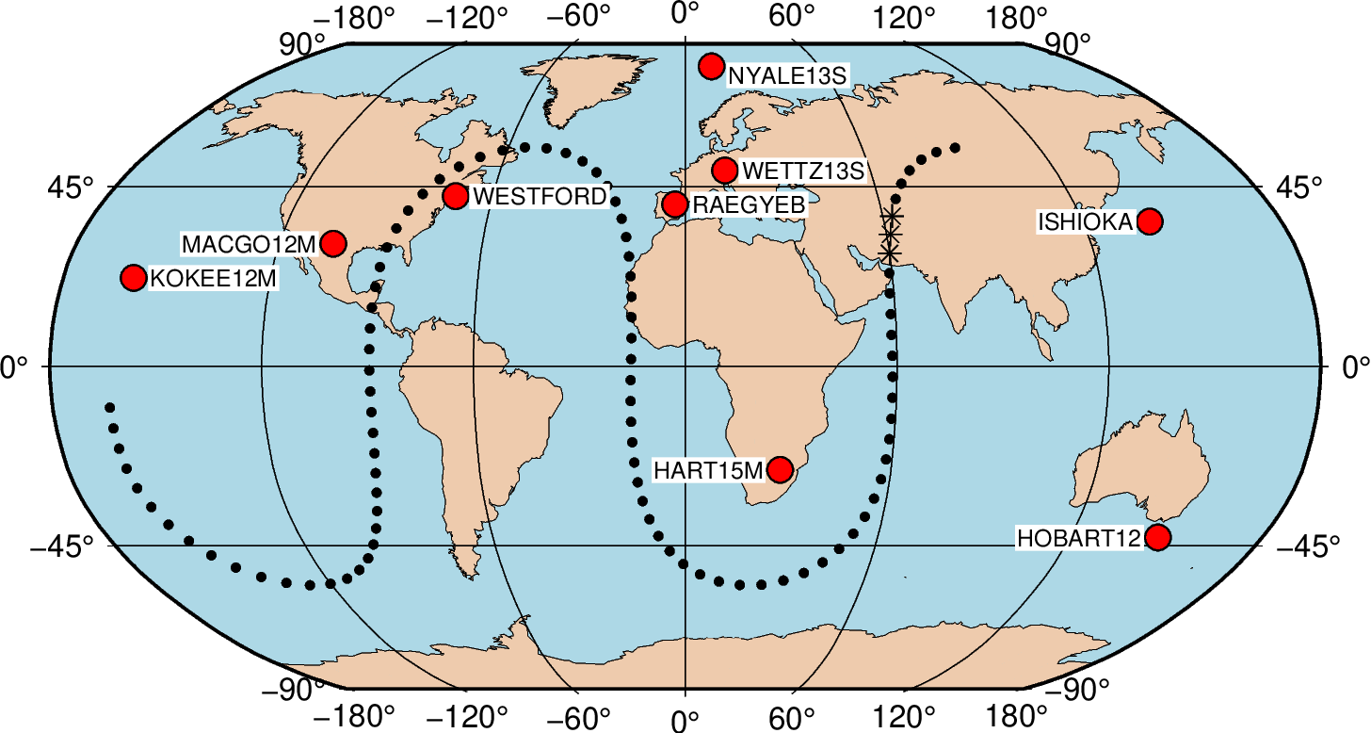
Estimation of Orbital Elements
satellite observations from 21:50 – 22:30 with 5 stations

Slide 11
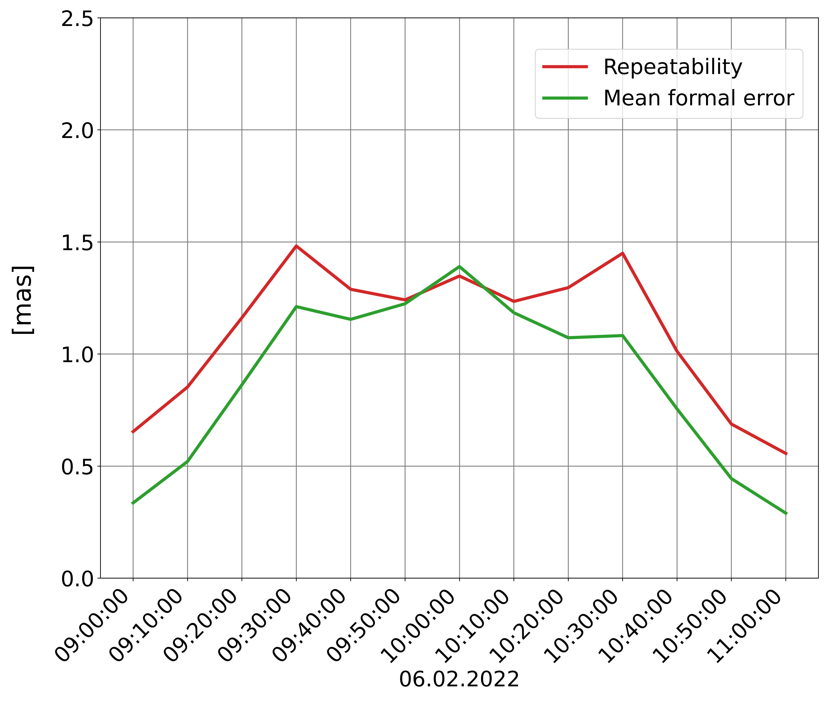
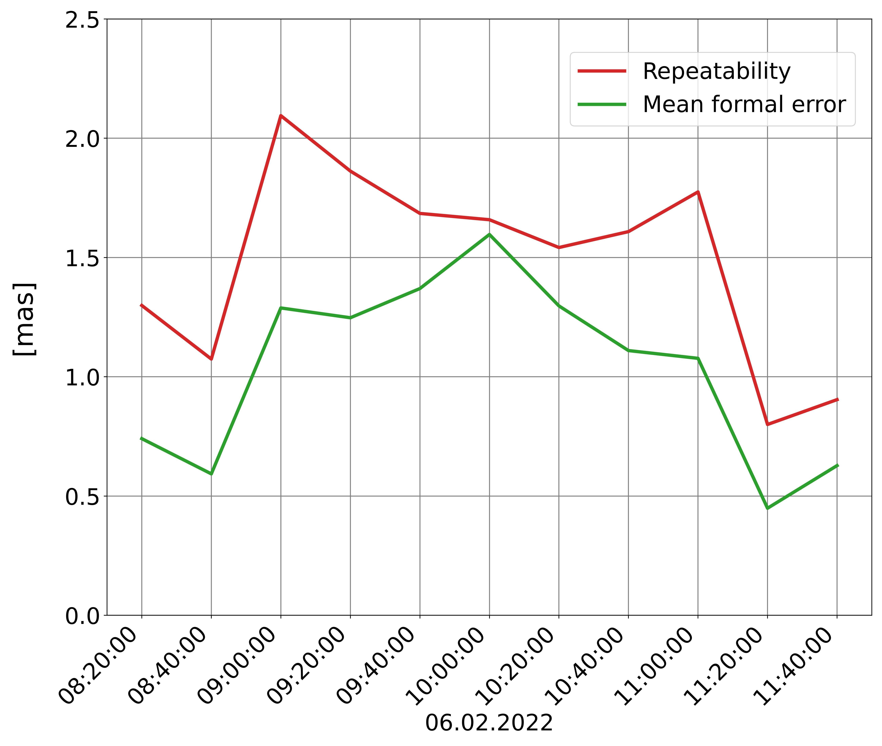
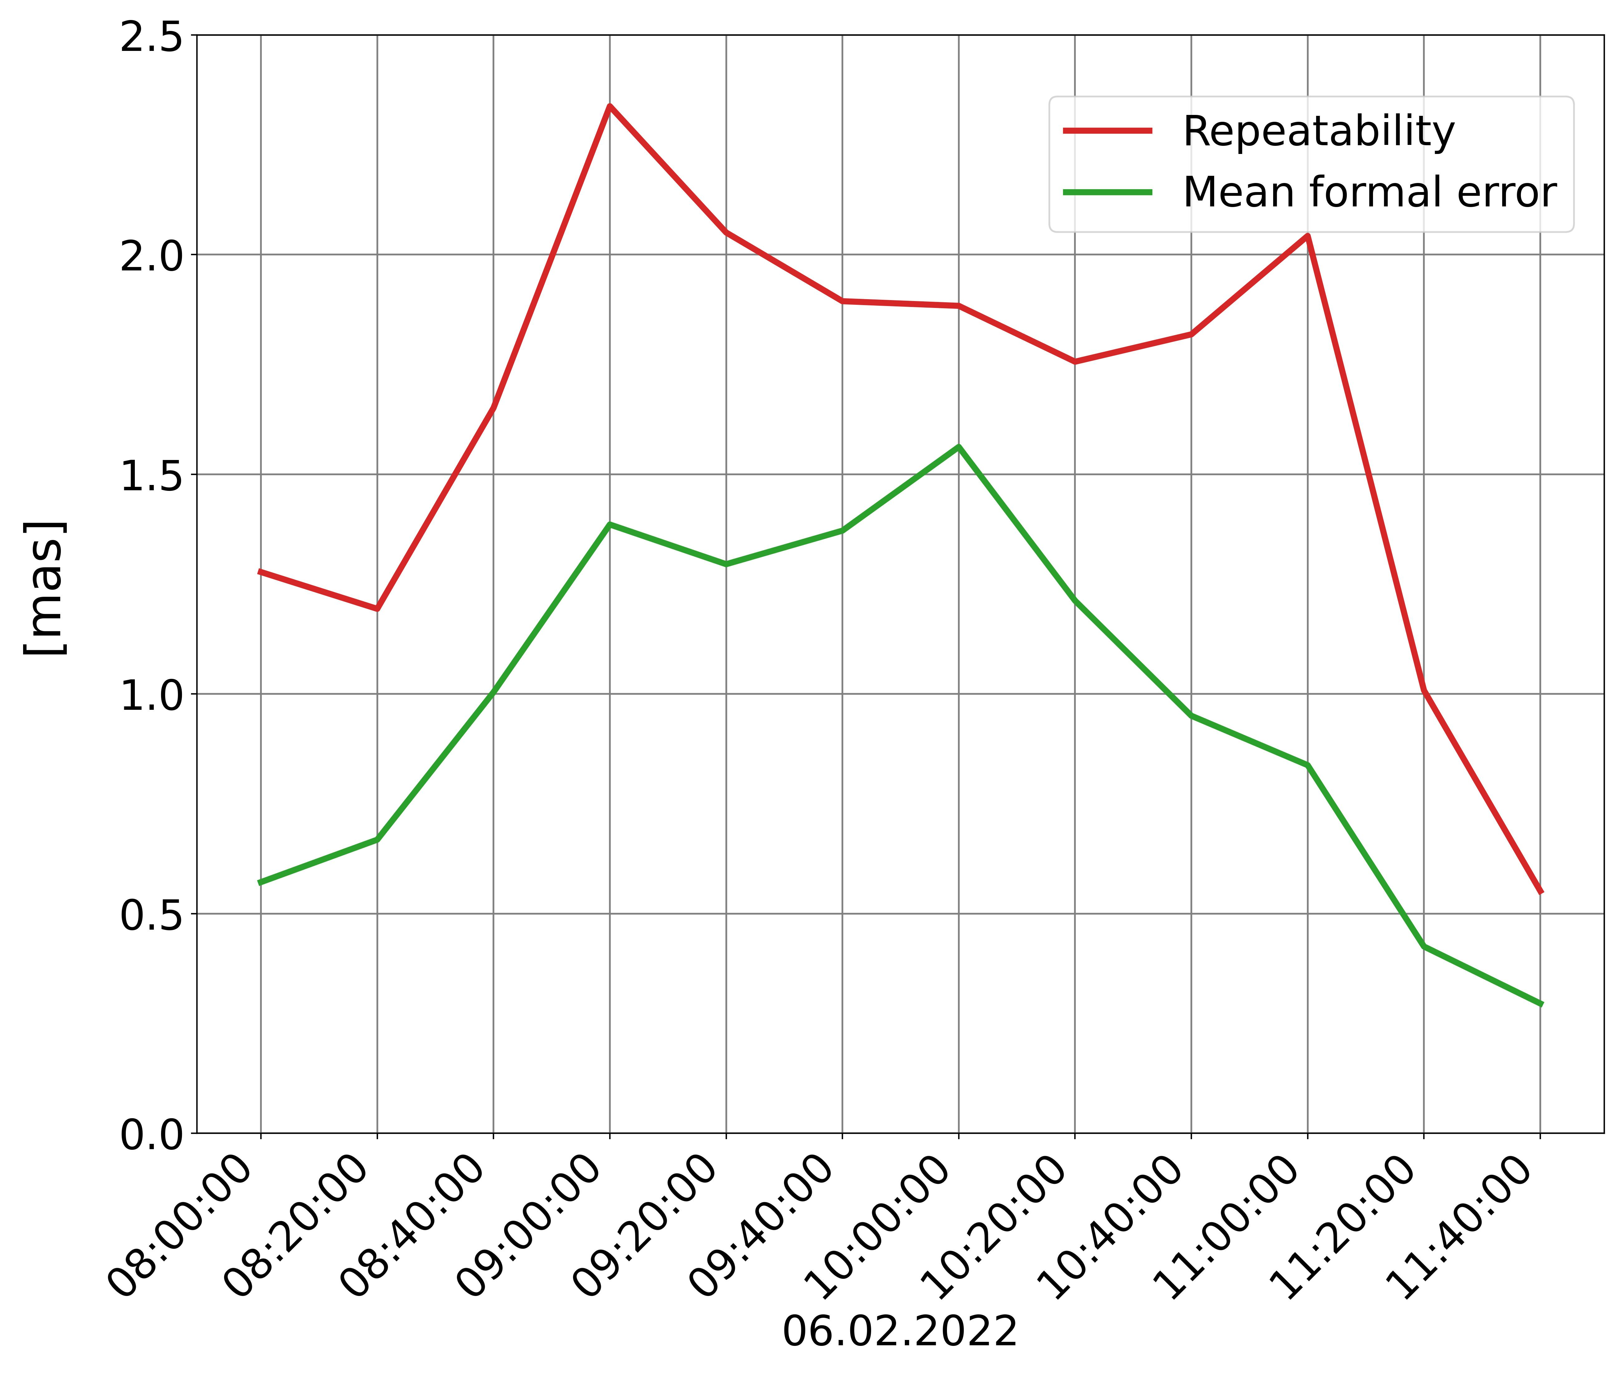
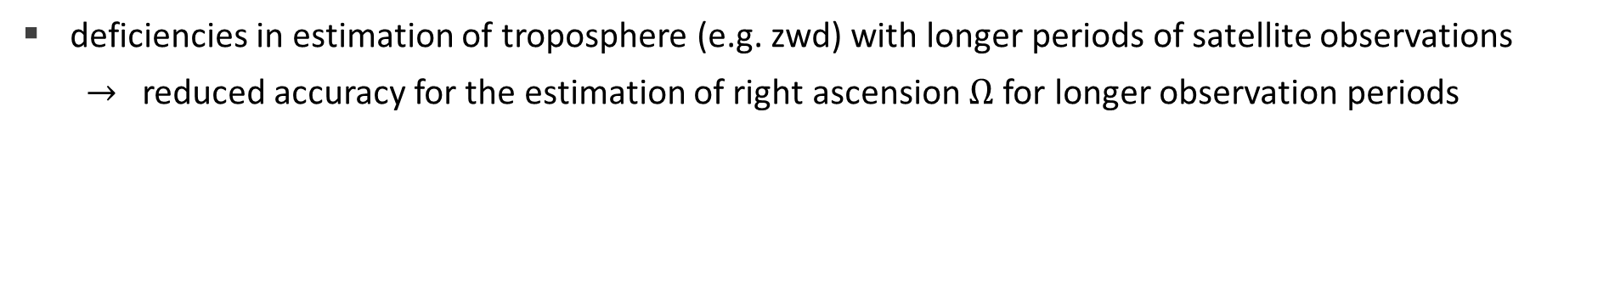
Estimation of Orbital Elements
deficiencies in estimation of troposphere (e.g. zwd) with longer periods of satellite observations
$→$ reduced accuracy for the estimation of right ascension $Ω$ for longer observation periods
2 hours of satellite observations
3 hours of satellite observations
3,5 hours of satellite observations
Notes:
9:00 – 11:00
8:30 – 11:30
8:10 – 11:40

Slide 12
Deficiencies in Estimation of Troposphere
2 hours of satellite observations

Slide 13
Deficiencies in Estimation of Troposphere
3 hours of satellite observations

Slide 14
Deficiencies in Estimation of Troposphere
3,5 hours of satellite observations

Slide 15
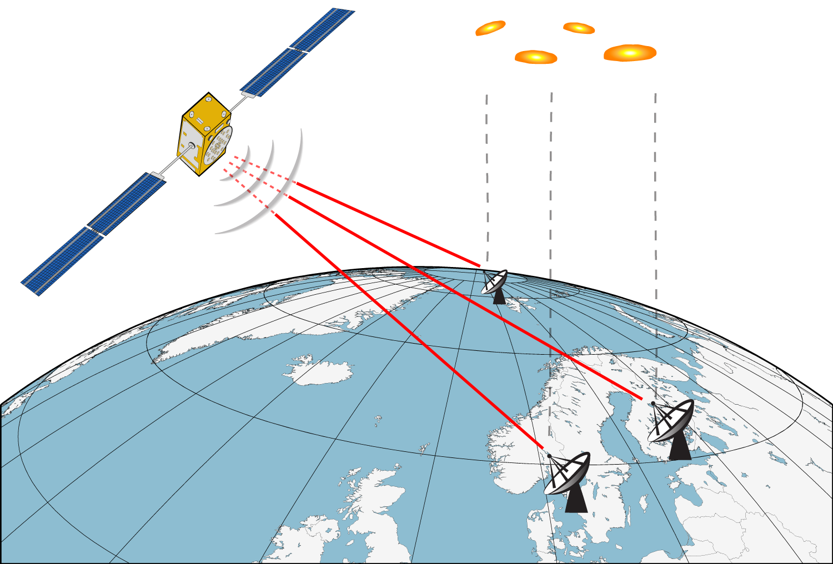

Conclusion
more investigations needed, e.g.,
    how many quasar scans in between for sufficient troposphere determination
    relationship with estimated satellite position in NTW-frame
    dependence on observation geometry
estimation of other orbital elements

Slide 16
References
Wolf H. (2021): Satellite Scheduling with VieSched++, Master Thesis, Technical University of Vienna.
Wolf et al. (2022): Dilution of Precision (DOP) factors for evaluating observations to Galileo satellites with VLBI, International Association of Geodesy Symposia, Springer, Berlin, Heidelberg.
Belli F. (2020): Transfer of absolute orientation to Galileo orbits with VLBI, Master thesis, Technical University of Munich.
Hellerschmied A. (2018): Satellite Observations with VLBI, Doctoral Thesis, Technical University of Vienna.
Zajdel et al. (2020): System-specific systematic errors in earth rotation parameters derived from GPS, GLONASS, and Galileo, GPS Solut 24, 74.
VieSched++: https://github.com/TUW-VieVS/VieSchedpp/

Slide 17
Appendix

Slide 18

Deficiencies in Estimation of Troposphere
9:00 – 11:00 $→$ 2:00h

Slide 19

Deficiencies in Estimation of Troposphere
8:30 – 11:30 $→$ 3:00h

Slide 20

Deficiencies in Estimation of Troposphere
8:10 – 11:40 $→$ 3:30h

