Slide 1
Draconitic, tidal, and orbital
aliasing signals in multi-GNSS solutions
Krzysztof Sośnica, Radosław Zajdel, Grzegorz Bury, and Kamil Kaźmierski
Institute of Geodesy and Geoinformatics, UPWr, Wroclaw, Poland
Notes:
Hello everyone, my name is Radosław Zajdel and in this presentation I want to highlight the differences in the polar motion and Length-of-Day estimates when using various GNSS constelations: GPS, GLONASS and Galileo

Slide 2
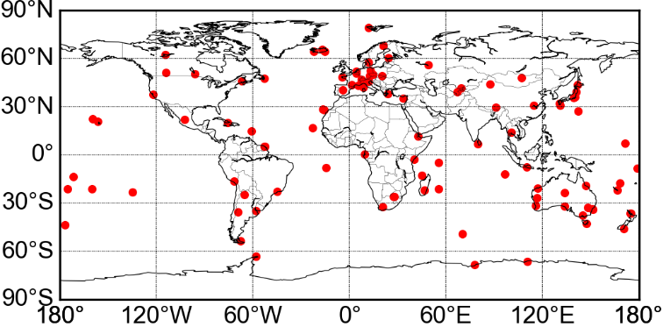

Processing strategy – global multi-GNSS solutions
GPS + GLONASS + Galileo
~100 stations
(all of which track GPS/GLONASS/Galileo)
Double-difference network solution
ERPs are calculated:
a) in sub-daily resolution → 2h
b) in daily resolution → 24h
Solar Radiation Pressure Modelling
a) ECOM2
b) box-wing + const. acc. in 3 directions
Solution | Systems | Orbit modelling
GRE | GPS+Galileo +GLONASS | ECOM2 (7 par)
GPS | GPS | ECOM2 (7 par)
GLO | GLONASS | ECOM2 (7 par)
GAL | Galileo | ECOM2 (7 par)
GAB | Galileo | box-wing & D₀, Y₀, B₀
Galileo Satellite Metadata
Notes:
Firstly, let us focus on the pole coordinates estimated with daily sampling, delivered from single-system solutions, combined multi-GNSS solution and Galileo solution with improved approach for the orbit modeling using satellite metadata.
The spectra analysis reveals two groups of artificial signals:
Signals with periods at the harmonics of the draconitic year
Signals at the resonant periods between Earth rotation and satellite revolution period.
Giving both frequencies we can calcuate the set of theoretical periods, which match well with the observations.
We may distinguish even more resonant signals in the sub-daily domain. So let’s have a look at the analysis of the pole coordinates estimated with the sampling of 2h.

Slide 3
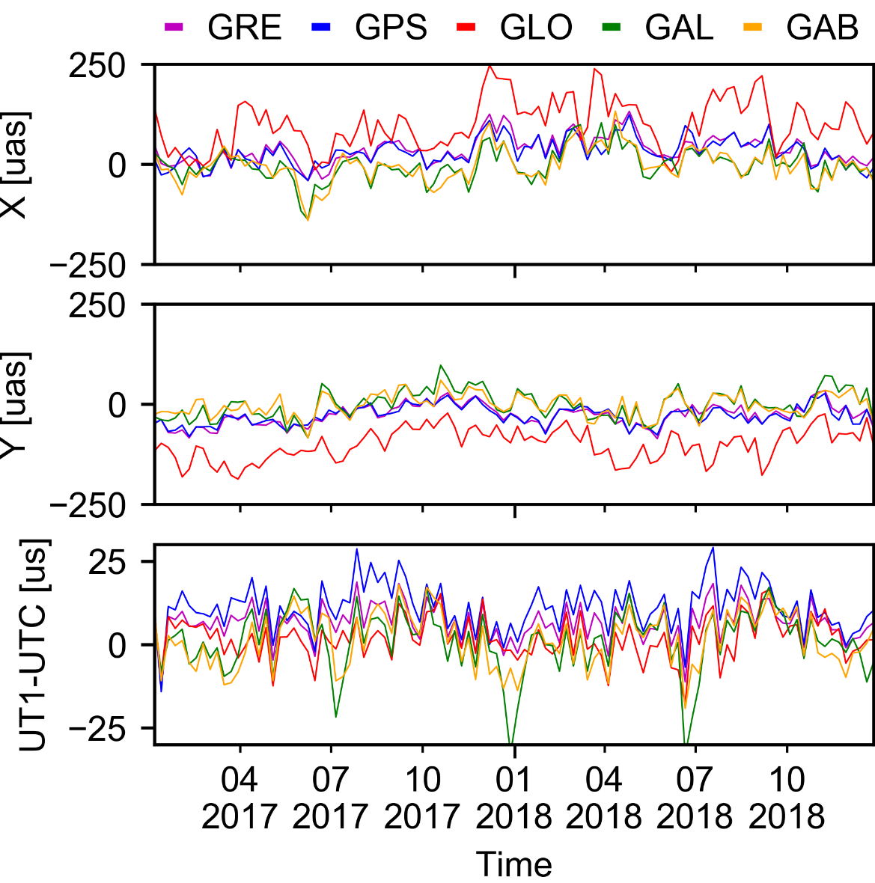
Polar motion from GPS, GLONASS, Galileo w.r.t. IERS-C04-14
 | X [µas] |  | Y [µas]
 | AVG | RMS | AVG | RMS
GRE | 36 | 69 | -27 | 57
GPS | 31 | 66 | -28 | 57
GLO | 100 | 134 | -101 | 123
GAL | -2 | 72 | -1 | 66
GAB | -3 | 77 | -2 | 61
Galileo delivers the
daily ERPs of almost the same quality as the GPS does and much better quality than that from GLONASS.
IERS-C04-14 is dominated by GPS, however, Galileo still provides comparable results!
GAB = Galileo with a box-wing model
based on metadata
GAL = Galileo with empirical ECOM model only
Zajdel R., Sośnica K., Bury G., Dach R., Prange L. (2022) System-specific systematic errors in earth rotation parameters derived from GPS, GLONASS, and Galileo
GPS Solutions, URL: https://link.springer.com/article/10.1007/s10291-020-00989-w

Slide 4

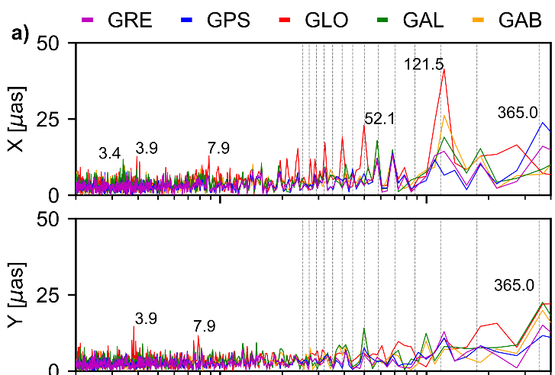

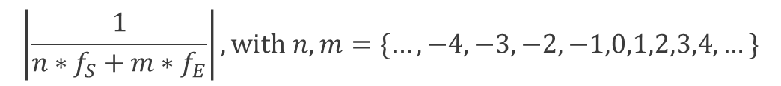
Polar motion from GPS, GLONASS, Galileo w.r.t. IERS-C04-14
The spectral analysis reveals 2 groups of artificial signals:
multi-GNSS
single-system
Galileo+
Harmonics of the draconitic year
Resonances between Earth rotation and satellite revolution period
When f_{E} and f_{S} are the frequencies of Earth rotation and satellite revolution, respectively, then we have:
Draconitic signals
$$\left|\frac{1}{{n∗f}_{S}+{m∗f}_{E}}\right|, with n,m=\{…,−4,−3,−2,−1,0,1,2,3,4,…\}$$
1/7
1/5
1/3
1/2
For Galileo-based solutions:
2.5 days (n=2, m=-3),
3.4 days (n=1, m=-2)
For GLONASS-based solutions:
2.6 days (n=3, m=-6),
3.9 days (n=2, m=-4),
7.9 days (n=1, m=-2)
Orbital resonances
Notes:
Firstly, let us focus on the pole coordinates estimated with daily sampling, delivered from single-system solutions, combined multi-GNSS solution and Galileo solution with improved approach for the orbit modeling using satellite metadata.
The spectra analysis reveals two groups of artificial signals:
Signals with periods at the harmonics of the draconitic year
Signals at the resonant periods between Earth rotation and satellite revolution period.
Giving both frequencies we can calcuate the set of theoretical periods, which match well with the observations.
We may distinguish even more resonant signals in the sub-daily domain. So let’s have a look at the analysis of the pole coordinates estimated with the sampling of 2h.

Slide 5
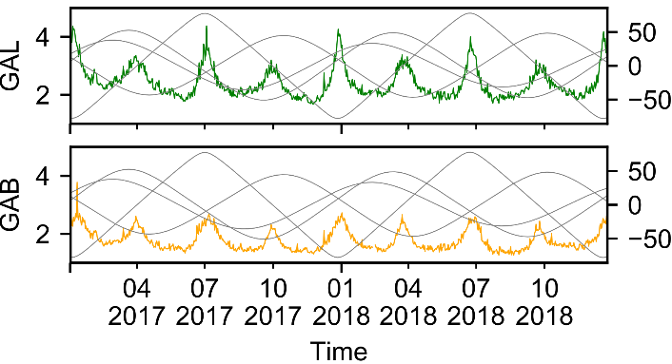
Length-of-Day (LoD) / UT1-UTC w.r.t. IERS-14-C04
LoD delivered from Galileo is more consistent with IERS-C04 than GPS, however, contains a systematic patterns in 1-day solutions. Generating 3-day Galileo arcs removes this pattern.
GPS has a large offset in the LoD solutions, which results in the secular drift of the accumulated LoD (UT1-UTC) due to orbital resonances.
GLONASS and Galileo have
much smaller offsets, however,
the combined solution is
dominated by GPS.
FORMAL ERRORS 1-day arcs
Notes:
Finally we characterized the daily Length-of-Day estimates with respect to the IERS C04 product.
Three types of errors can be distinguished from the spectral analysis.
Draconitic errors and orbital resonances, similarly to the polar motion.
The aliasing periods arising from the errors in sub-daily ERP tidal model. This group appears independetly of the constelation used.
The LoD estimates delivered from GPS has also a large secular drift of the accumulated LOD, which is not visible for the GLONASS and Galileo solutions.

Slide 6
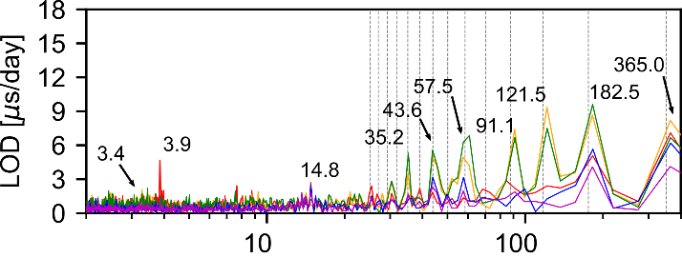
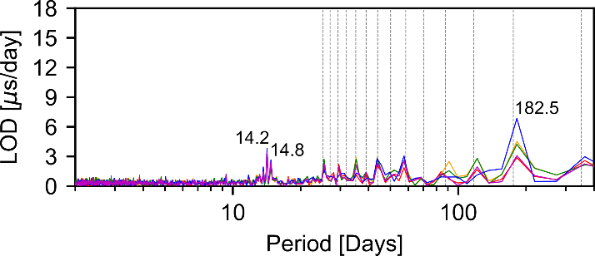
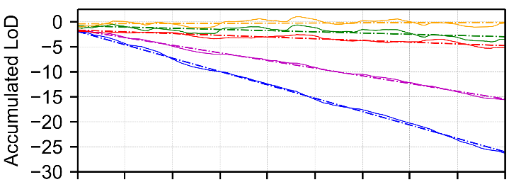

Length-of-Day (LoD) w.r.t. IERS-14-C04
1-day arcs
Draconitic artifacts
Orbital
resonances
Three types of errors can be distinguished in LoD:
Draconitic errors and Orbital resonances
Aliasing periods between 24h sampling and errors in sub-daily ERP tidal model:
14.8 days (M₂), 14.2 days (O₁)
-> visible in all solutions independently of the constellation (solutions based on sub-daily models from the IERS Conventions 2010)
Alias with sub-daily
tidal model
3-day arcs + pulses
GLONASS and Galileo have
much smaller drifts than GPS.
 | LoD [µs/d]
 | mean | RMS
GRE | -13 | 10
GPS | -22 | 12
GLO | -3 | 16
GAL | -2 | 22
GAB | 1 | 21
Notes:
Finally we characterized the daily Length-of-Day estimates with respect to the IERS C04 product.
Three types of errors can be distinguished from the spectral analysis.
Draconitic errors and orbital resonances, similarly to the polar motion.
The aliasing periods arising from the errors in sub-daily ERP tidal model. This group appears independetly of the constelation used.
The LoD estimates delivered from GPS has also a large secular drift of the accumulated LOD, which is not visible for the GLONASS and Galileo solutions.

Slide 7
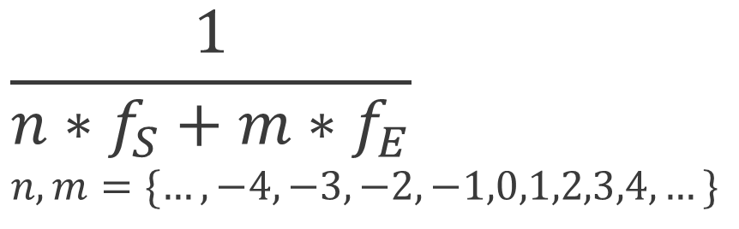
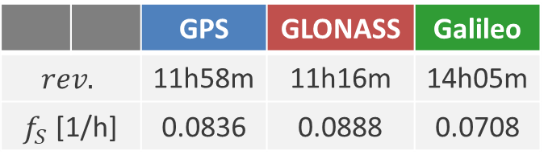
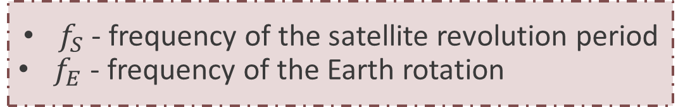
Orbital signals in GNSS-based series
$f_{S}$ - frequency of the satellite revolution period
$f_{E}$ - frequency of the Earth rotation
$$\frac{1}{{n∗f}_{S}+{m∗f}_{E}} \\ n,m=\{…,−4,−3,−2,−1,0,1,2,3,4,…\}$$
 |  | GPS | GLONASS | Galileo
$$rev.$$ |  | 11h58m | 11h16m | 14h05m
$f_{S}$ [1/h] |  | 0.0836 | 0.0888 | 0.0708
Example for Galileo [h]
The calculated periods dominate in the sub-daily domain
n\m | -4 | -3 | -2 | -1 | 0
0 | -5.98 | -7.98 | -11.97 | -23.93 | -
1 | -10.40 | -18.40 | -79.65 | 34.22 | 14.08
2 | -39.82 | 59.99 | 17.11 | 9.98 | 7.04
3 | 21.79 | 11.41 | 7.72 | 5.84 | 4.69
4 | 8.55 | 6.30 | 4.99 | 4.13 | 3.52
Notes:
Here we see the spectral analysis of the polar motion in the prograde direction for the same set of solutions.
All the single-system solutions are affected by the non-tidal signals with orbital periods dependent on the satellite revolution period.
The most dominant are 34h for Galileo and 21h for GLONASS.
We see also the differences at the tidal periods, so we fit 38 tidal terms and compared the results with three independent models.
The best agreement we obtained for the multi-GNSS solution, while the Galileo gives the best results among the other single-systems.

Slide 8
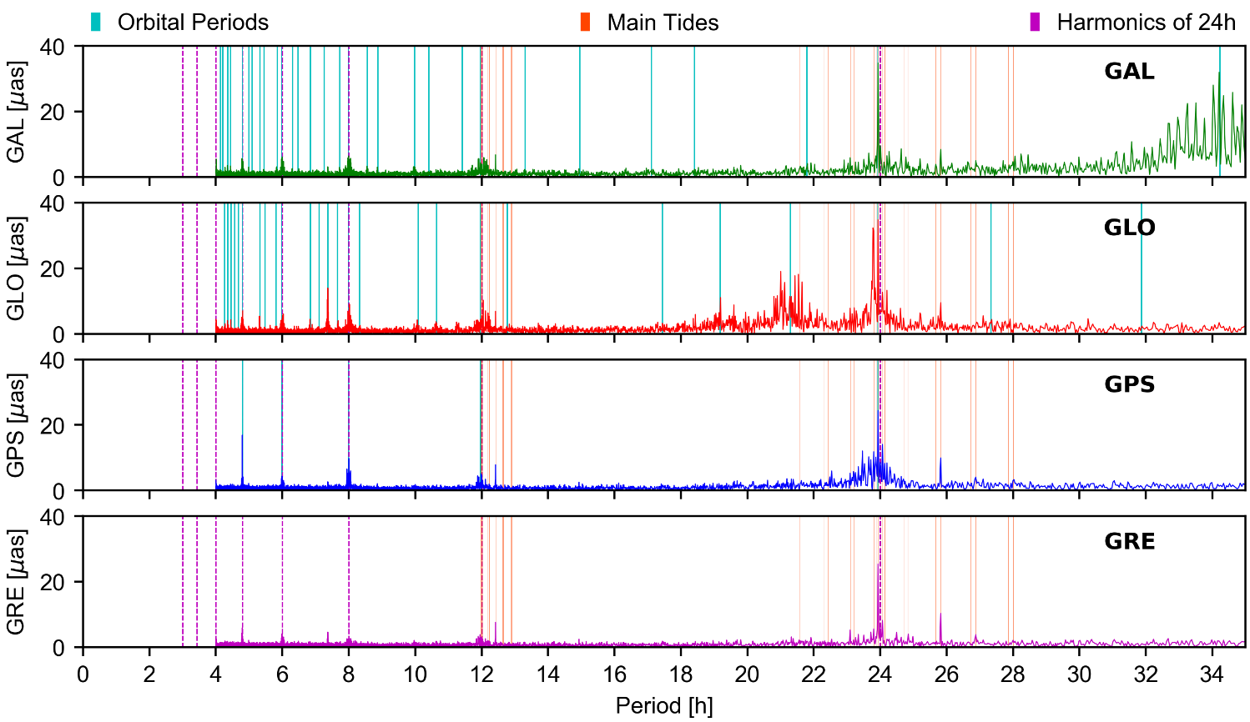
Sub-daily polar motion from Galileo, GLONASS, and GPS - prograde domain
Existence of artifacts at orbital resonances at diurnal and semidiurnal terms for GPS (K₁, K₂)
Amplitudes (differences w.r.t. a priori model) reach
20-30 µas
3-day arc reduces the amplitudes of
orbital artifacts
by up to 20-30%
^{34.22}
^{7.37}
^{21.29}
^{19.17}
^{4.79}
^{5.98}
^{7.98}
^{11.97}
^{23.93}
^{23.93}
^{7.37}
Zajdel R.,, Sośnica K., Bury G., Dach R., Prange L., Kaźmierski K.
Sub-daily polar motion from GPS, GLONASS, and Galileo
Journal of Geodesy, Vol. 95 No. 3, 2021, DOI: 10.1007/s00190-020-01453-w
Notes:
Problem tworzenia jednorodnych orbit multi-GNSS oparty jest m.in. na różnorodności konstelacji satelitów nawigacyjnych (slajd)
Skupie się więc na przykładach dwóch konstelacji GLONASS i Galileo

Slide 9
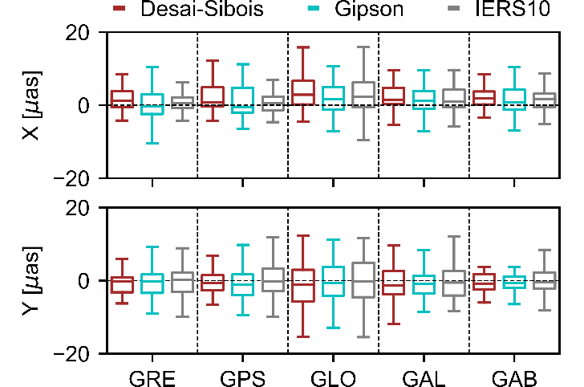
Sub-daily polar motion from GNSS w.r.t. external models
34 main tidal frequencies have been fitted to the series of GNSS-based pole coordinates using LSA
The sine and cosine coefficients of the tides have been compared in µas
with external models
Reference | Value | Solution
 |  | GRE | GPS | GLO | GAL | GAB
Desai-Sibois | X | 12.7 | 16.4 | 20.3 | 14.9 | 12.0
Gipson | X | 20.8 | 17.7 | 17.8 | 16.7 | 17.3
IERS2010 | X | 10.5 | 11.6 | 25.5 | 15.4 | 13.9
Desai-Sibois | Y | 12.1 | 13.5 | 27.6 | 21.4 | 9.7
Gipson | Y | 18.1 | 19.2 | 24.0 | 17.0 | 10.2
IERS2010 | Y | 18.8 | 21.7 | 27.0 | 20.4 | 16.6
General consistency at the level of 10 – 20 µas
Galileo (box-wing) solution is even more consistent with external models than GPS
Combination is still dominated by GPS
Notes:
Here we see the spectral analysis of the polar motion in the prograde direction for the same set of solutions.
All the single-system solutions are affected by the non-tidal signals with orbital periods dependent on the satellite revolution period.
The most dominant are 34h for Galileo and 21h for GLONASS.
We see also the differences at the tidal periods, so we fit 38 tidal terms and compared the results with three independent models.
The best agreement we obtained for the multi-GNSS solution, while the Galileo gives the best results among the other single-systems.

Slide 10
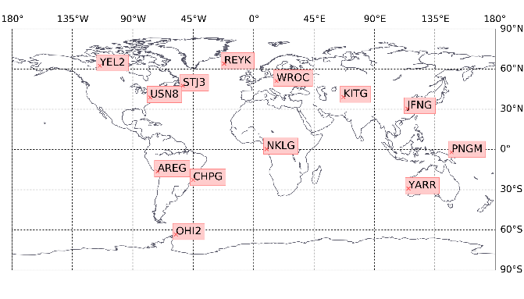
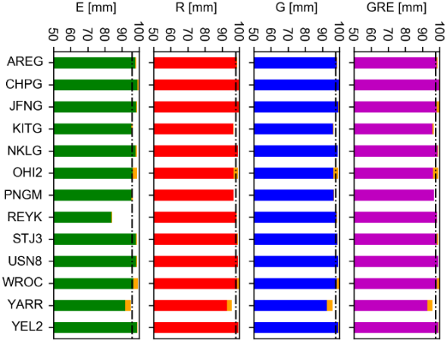
Precise Point Positioning (PPP) GNSS solutions
Software | GNSS-WARP (Hadas, 2015)
Observables | Undiferenced uncombined model with pseudorange and carrier-phase
Frequencies (RINEX 3.03 notation) | GPS: L1/L2, GLONASS: G1/G2, Galileo: E1/E5a,
Inter-system weighting | elevation e dependent weighting: sin(e)
Sampling rate and test period | 60 s → 01/2019 | 12/2020 (2 years)
Troposphere delay modeling | GMF and a priori value for hydrostatic delay, wet delay estimated Chen and Herring (1997)
Satellite orbits and clocks | fixed from TUG R3 mutli-GNSS
Code and phase biases | TUG R3 multi-GNSS
Anntenna calibration | igsR3_2077.atx (consistent with TUG R3 products)
Correction models | phase wind-up, relativistic delays, solid earth tides (IERS 2010), receiver antenna phase center offset and variation, ocean tidal loading (FES2014), sub-daily variations in Earth rotation (Desai-Sibois, 2016)
Outputs | Station coordinates: 24 h Receiver Clocks: 60 s as a White Noise Troposphere Zenit Total Delay: 24 h
GLONASS-only (R)
multi-GNSS (GRE)
Galileo-only (E)
GPS-only (G)
13 stations selected for tests
IGS Repro3 products
(TUG contribution, Strasser et al. 2021)
multi-GNSS antenna calibartions (IGSR3_2077.atx)
New background models
(consistent with TUG products, e.g., FES2014, HF EOP (Desai Sibois, 2016)
Float ambiguities
System-specific solutions
Good: 96.6% 97.8% 97.5% 97.1%
epochs
Notes:
Problem tworzenia jednorodnych orbit multi-GNSS oparty jest m.in. na różnorodności konstelacji satelitów nawigacyjnych (slajd)
Skupie się więc na przykładach dwóch konstelacji GLONASS i Galileo

Slide 11
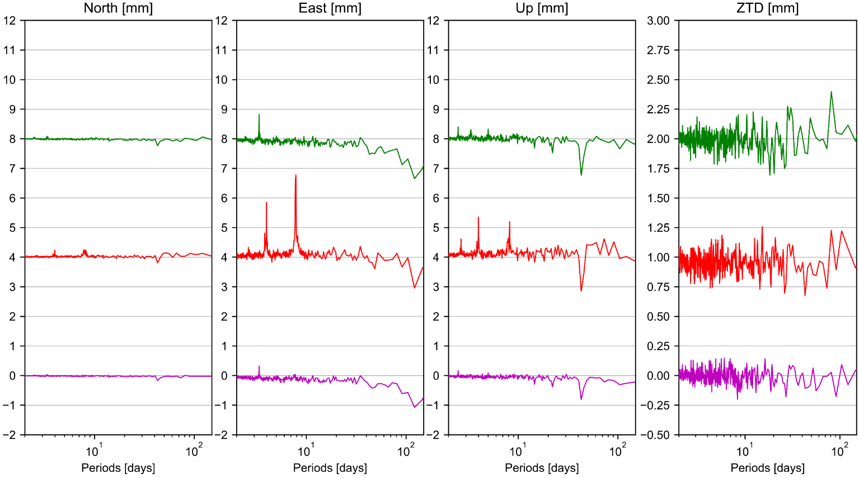

Daily PPP solutions
Stacked periodogram of FFT differences w.r.t. GPS-only solution
Stacked periodogram from all 13 independent stations
Series shifted along y-axis
Signals above „0” – Insertion of system-specific artifacts
Signals below „0” – Reduction of GPS artifacts
Resonances between Earth rotation and satellite revolution period (orbital periods)
When f_{E} and f_{S} are the frequencies of Earth rotation and satellite revolution, respectively, then we have:
Galileo - GPS
GLONASS - GPS
Multi-GNSS - GPS
$$\left|\frac{1}{{n∗f}_{S}+{m∗f}_{E}}\right|$$
Notes:
Problem tworzenia jednorodnych orbit multi-GNSS oparty jest m.in. na różnorodności konstelacji satelitów nawigacyjnych (slajd)
Skupie się więc na przykładach dwóch konstelacji GLONASS i Galileo

Slide 12
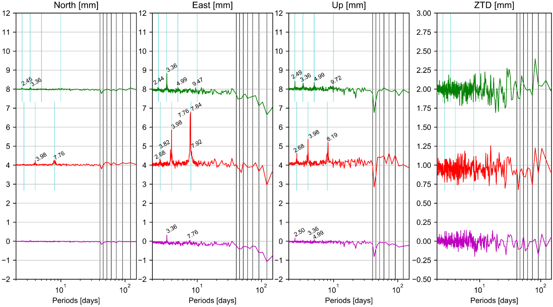
Daily PPP solutions
Stacked periodogram of FFT differences w.r.t. GPS-only solution
Stacked periodogram from all 13 independent stations
Series shifted along y-axis
Signals above „0” – Insertion of system-specific artifacts
Signals below „0” – Reduction of GPS artifacts
Resonances between Earth rotation and satellite revolution period (orbital periods)
When f_{E} and f_{S} are the frequencies of Earth rotation and satellite revolution, respectively, then we have:
Labels in days!
Galileo - GPS
GLONASS - GPS
Multi-GNSS - GPS
$$\left|\frac{1}{{n∗f}_{S}+{m∗f}_{E}}\right|$$
Notes:
Problem tworzenia jednorodnych orbit multi-GNSS oparty jest m.in. na różnorodności konstelacji satelitów nawigacyjnych (slajd)
Skupie się więc na przykładach dwóch konstelacji GLONASS i Galileo

Slide 13
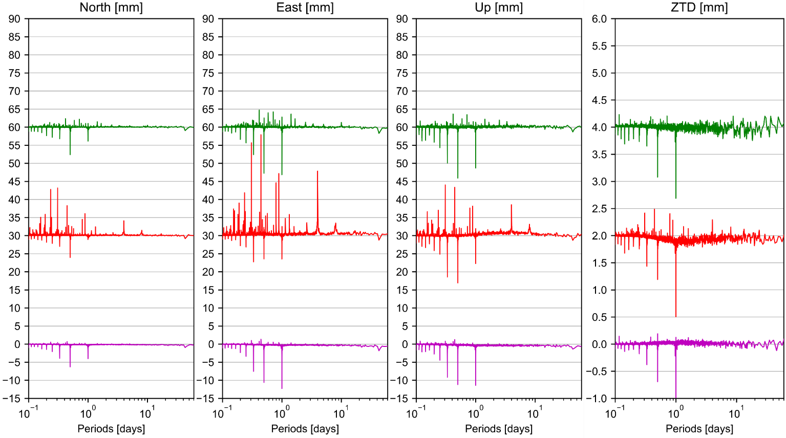
Sub-daily PPP solutions
Stacked periodogram of FFT differences w.r.t. GPS-only solution
Stacked periodogram from all 13 independent stations
Series shifted along y-axis
Signals above „0” – Insertion of system-specific artifacts
Signals below „0” – Reduction of GPS artifacts
Galileo - GPS
GLONASS - GPS
Multi-GNSS - GPS
Notes:
Problem tworzenia jednorodnych orbit multi-GNSS oparty jest m.in. na różnorodności konstelacji satelitów nawigacyjnych (slajd)
Skupie się więc na przykładach dwóch konstelacji GLONASS i Galileo

Slide 14
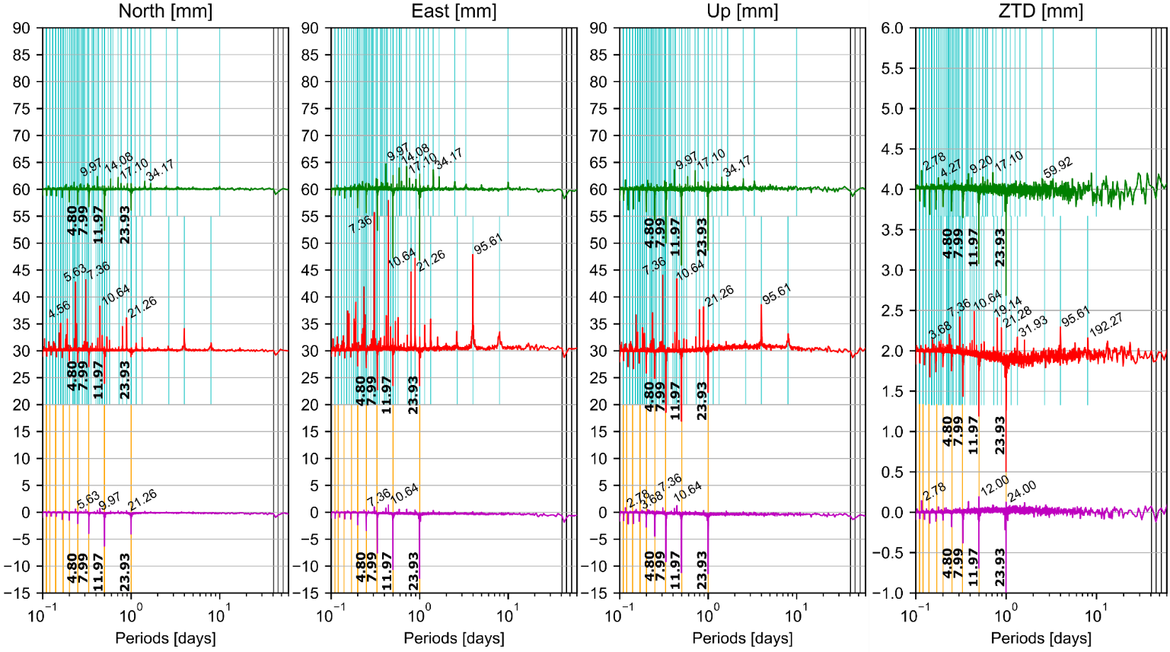
Sub-daily PPP solutions
Stacked periodogram of FFT differences w.r.t. GPS-only solution
Stacked periodogram from all 13 independent stations
Series shifted along y-axis
Signals above „0” – Insertion of system-specific artifacts
Signals below „0” – Reduction of GPS artifacts
Signals at the orbital periods specific for each system
Using-multi GNSS reduces the spuriously large GPS signals at the harmonics of sidereal day
Labels in hours!
Galileo - GPS
GLONASS - GPS
Multi-GNSS - GPS
Zajdel R., Kaźmierski K., Sośnica K. (2022) Orbital artifacts in multi-GNSS Precise Point Positioning time series. Journal of Geophysical Research: Solid Earth, URL: https://agupubs.onlinelibrary.wiley.com/doi/10.1029/2021JB022994
Notes:
Problem tworzenia jednorodnych orbit multi-GNSS oparty jest m.in. na różnorodności konstelacji satelitów nawigacyjnych (slajd)
Skupie się więc na przykładach dwóch konstelacji GLONASS i Galileo

Slide 15
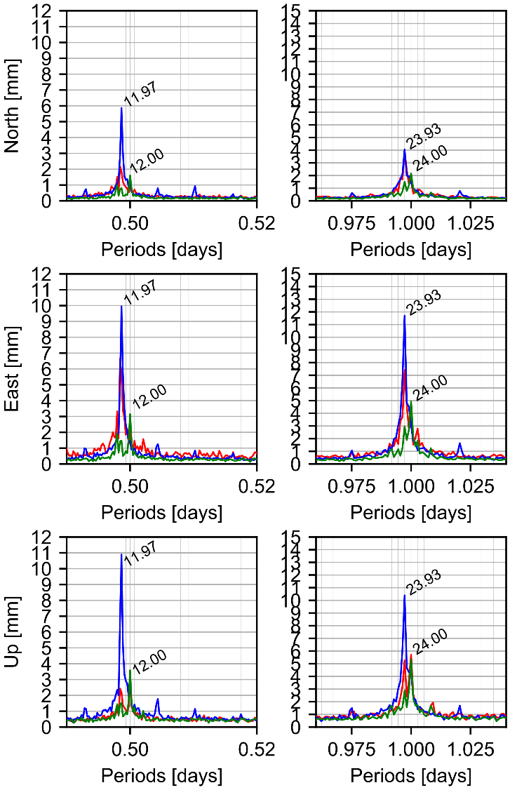
Summary
GNSS series contains draconitic, tidal, and orbital signals
Orbital resonances occur for diurnal and semidiurnal tidal constituents (K1/K2) for GPS due to the resonances with the revolution period
Draconitic errors can be reduced by improved orbit modeling or increasing the number of satellite orbital planes
Galileo remarkably stabilizes the PPP solutions, especially the long-term East component, whereas GLONASS introduces spurious artifacts into GNSS PPP
Multi-GNSS combination and the Galileo solutions substantially reduce the PPP position errors in diurnal, semidiurnal, terdiurnal terms, etc. w.r.t. GPS solutions
Notes:
Firstly, let us focus on the pole coordinates estimated with daily sampling, delivered from single-system solutions, combined multi-GNSS solution and Galileo solution with improved approach for the orbit modeling using satellite metadata.
The spectra analysis reveals two groups of artificial signals:
Signals with periods at the harmonics of the draconitic year
Signals at the resonant periods between Earth rotation and satellite revolution period.
Giving both frequencies we can calcuate the set of theoretical periods, which match well with the observations.
We may distinguish even more resonant signals in the sub-daily domain. So let’s have a look at the analysis of the pole coordinates estimated with the sampling of 2h.

Slide 16

Thank you for your attention!
Krzysztof Sośnica
Institute of Geodesy and Geoinformatics, UPWr
krzysztof.sosnica@upwr.edu.pl

Slide 17
Further reading
Co-location:
Bury G., Sośnica K., Zajdel R., Strugarek D., Hugentobler U. (2021)
Geodetic datum realization using SLR-GNSS co-location onboard Galileo and GLONASS
Journal of Geophysical Research - Solid Earth, DOI: 10.1029/2021JB022211
Bury G., Sośnica K., Zajdel R., Strugarek D., Hugentobler U. (2021)
Determination of precise Galileo orbits using combined GNSS and SLR observations
GPS Solutions, DOI: 10.1007/s10291-020-01045-3
Strugarek D., Sośnica K., Arnold D., Jäggi A., Zajdel R., Bury G. (2021)
Determination of SLR station coordinates based on LEO, LARES, LAGEOS, and Galileo Satellites
Earth, Planets and Space, DOI: 10.1186/s40623-021-01397-1
Bury G., Sośnica K., Zajdel R. (2019)
Multi-GNSS orbit determination using satellite laser ranging
Journal of Geodesy, DOI: 10.1007/s00190-018-1143-1
Earth rotation parameters:
Zajdel R., Sośnica K., Bury G., Dach R., Prange L. (2020)
System-specific systematic errors in earth rotation parameters derived from GPS, GLONASS, and Galileo
GPS Solutions, DOI: 10.1007/s10291-020-00989-w
Zajdel R., Sośnica K., Bury G., Dach R., Prange L., Kaźmierski K. (2021)
Sub-daily polar motion from GPS, GLONASS, and Galileo
Journal of Geodesy, DOI: 10.1007/s00190-020-01453-w
PPP:
Zajdel R., Kaźmierski K., Sośnica K. (2022)
Orbital artifacts in multi-GNSS Precise Point Positioning time series
Journal of Geophysical Research: Solid Earth, Vol. DOI: 10.1029/2021JB022994
Hadaś T., Kaźmierski K., Sośnica K. (2019)
Performance of Galileo-only dual-frequency absolute positioning using the fully serviceable Galileo constellation
GPS Solutions, DOI: 10.1007/s10291-019-0900-9
General Relativity:
Sośnica K., Bury G., Zajdel R., Ventura-Traveset J., Mendes L. (2022)
GPS, GLONASS, and Galileo orbit geometry variations caused by general relativity focusing on Galileo in eccentric orbits
GPS Solutions, DOI: 10.1007/s10291-021-01192-1
Sośnica K., Bury G., Zajdel R., Kaźmierski K., Ventura-Traveset J., Prieto-Cerdeira R., Mendes L. (2021)
General relativistic effects acting on the orbits of Galileo satellites
Celestial Mechanics and Dynamical Astronomy, DOI: 10.1007/s10569-021-10014-y
Geocenter:
Zajdel R., Sośnica K., Bury G. (2021)
Geocenter coordinates derived from multi-GNSS: a look into the role of solar radiation pressure modeling
GPS Solutions, DOI: 10.1007/s10291-020-01037-3

