Slide 1


Global reference frame realization onboard GNSS satellites
Grzegorz Bury¹, Krzysztof Sośnica¹, Radosław Zajdel¹, Dariusz Strugarek¹, Urs Hugentobler²
¹ Institute of Geodesy and Geoinformatics, Wrocław University of Environmental and Life Sciences, Grunwaldzka 53, 50-357 Wroclaw, Poland
² Institute for Astronomical and Physical Geodesy, Technical University of Munich, 80333, Munich, Germany

Slide 2
Subject of this study
Geodetic Datum Realization using co-location onboard GNSS
  What is the best strategy for constraining GNSS and SLR network?
  How should we handle the SLR systematic errors (range biases)?
  How well can we determine the linkage between SLR and GNSS in space?

Slide 3
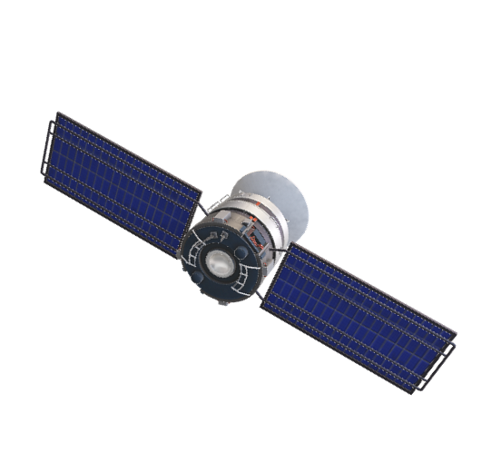
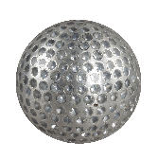

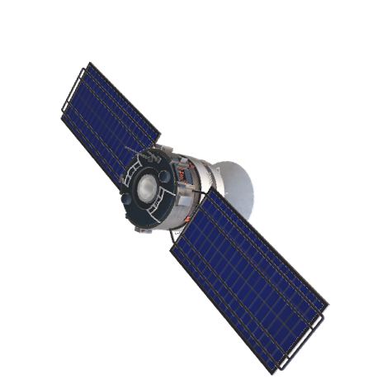


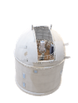

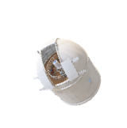










Local Tie
SLR: zero-difference
network solution
SLR:
ITRF
GNSS: double-difference
network solution
Geocenter is not explicitely estimated thus the SLR requires NNR, whereas GNSS network requires NNT+NNR constaint.

Slide 4
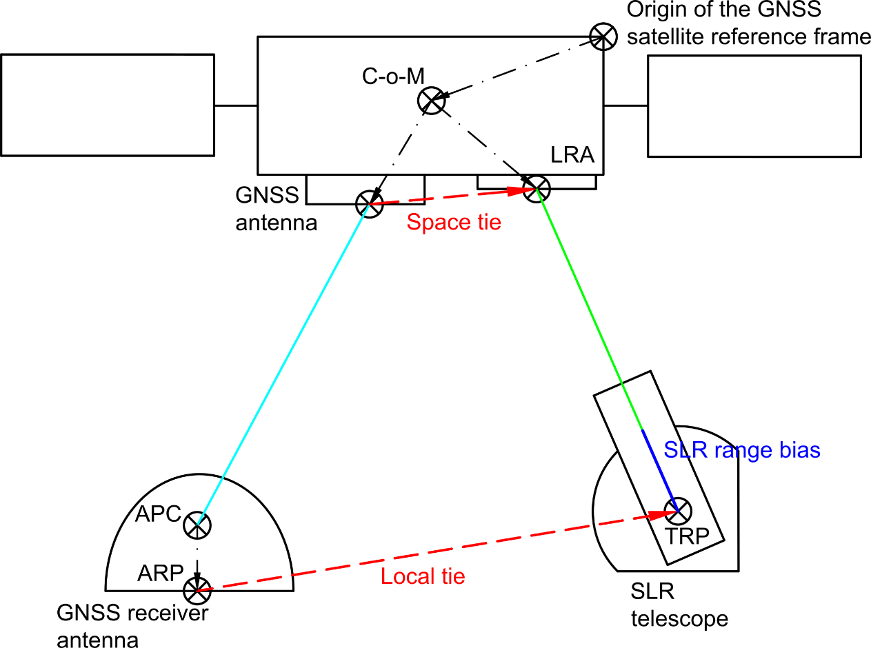
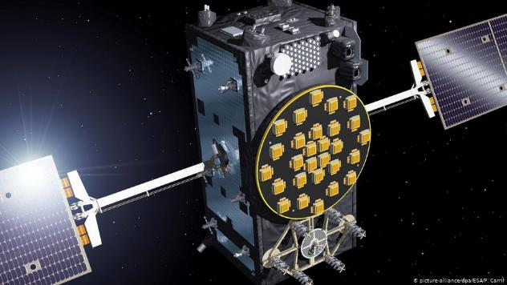
Integration of SLR and GNSS onboard Galileo (GNSS)
APC – GNSS antenna phase center
APR – GNSS antenna reference point
TRP – SLR telescope reference point
LRA – laser retroreflector array
C-o-M – GNSS satellite center-of-mass.
LRA for SLR
GNSS
antenna

Slide 5
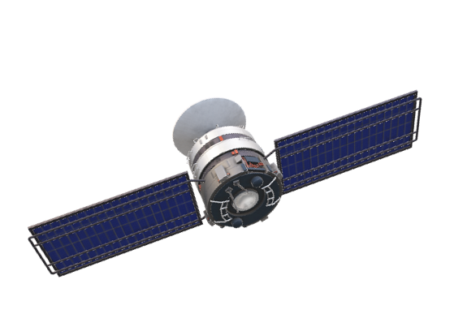
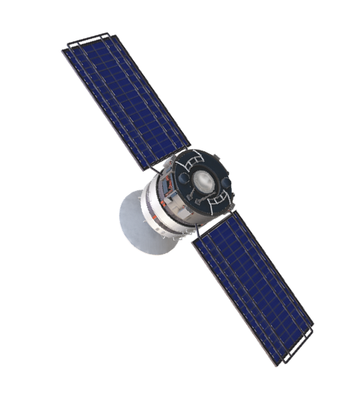
Do the space ties transfer the network orientation and translation?
Space Tie
SLR: zero-difference
network solution
SLR:
GNSS: double-difference
network solution
Space ties
NNT+NNR needed for SLR stations?
NNT+NNR needed for GNSS stations?
NNT+NNR needed for both, SLR and GNSS stations?

Slide 6
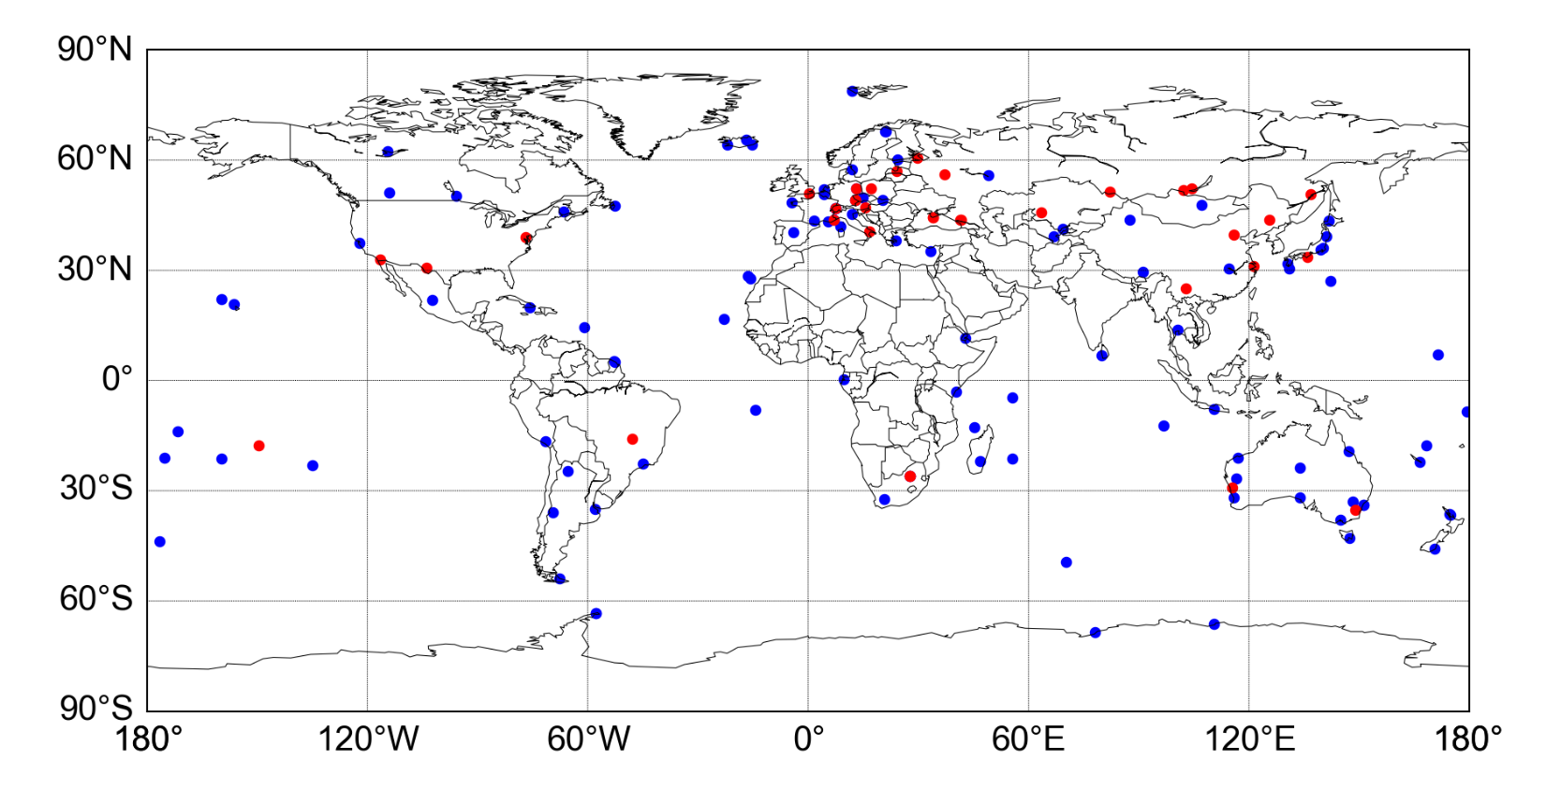

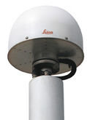
GNSS and SLR network
GNSS stations
SLR stations

Slide 7
Different approaches to the datum realization
Best for GNSS and SLR
Cannot realize SLR network (not bad for SLR stations!)
 | Solution | GNSS | SLR | GCC
Constraints on GNSS network | G1 | NNT/NNR | NO/NO | +
Constraints on GNSS+SLR networks | C1 | NNT/NNR | NNT/NNR | +
 | C2 | NNR | NNT | -
 | C3 | NNR | NNR | -
 | C4 | NNR/NNT | NNT | +
 | C5 | NNR | NNT/NNR | +
GCC in GNSS network
Similar to G1 – orientation for the SLR network cannot be transfered via GNSS satellites (lack of NNR condition)
Very poor GCC and CRD

Slide 8
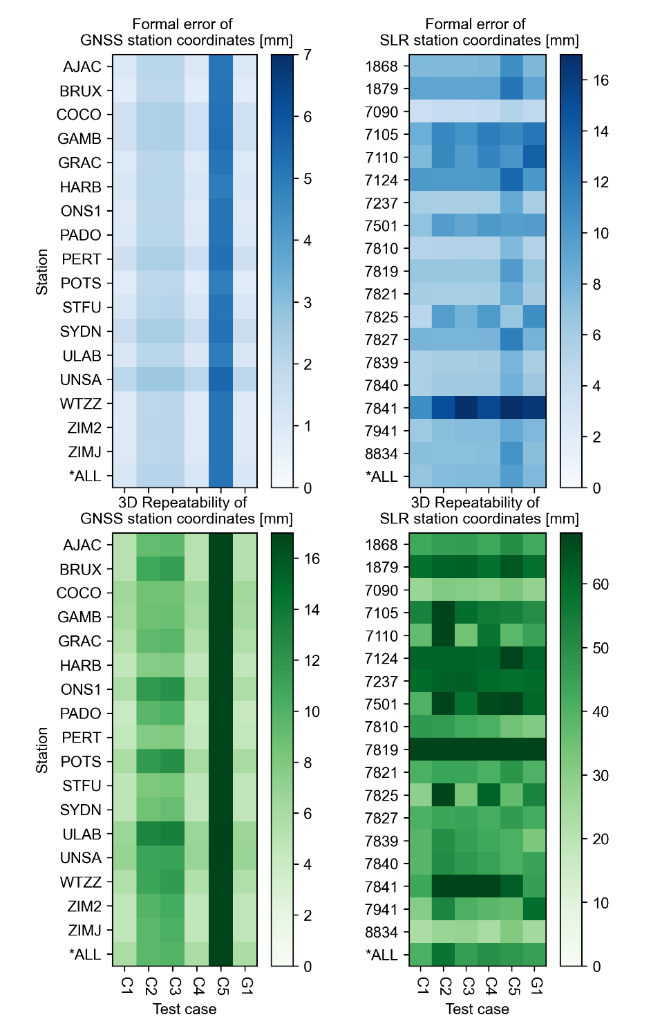
Quality of station coordinates
GNSS
SLR
Homogeneity of GNSS network
C1, C4, G1 – NNT/NNR + GCC
C2, C3– NNR – GCC
C5 – NNR + GCC
Inhomogeneity of SLR network
Best performing stations: 7090, 7810, 7941, 8834
C1 (NNT/NNR) and G1(No constraints!) the best for SLR station coordinates

Slide 9

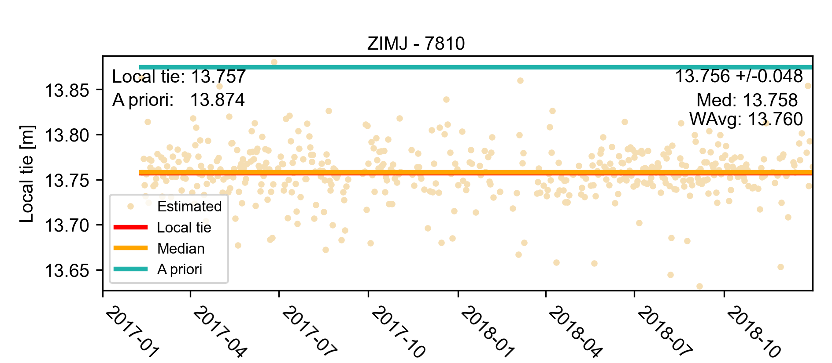
3D local tie (1/2)
Local tie
GNSS station
SLR station
GNSS-SLR stations distance based on the a priori ITRF2014/SLRF2014
Local tie calculated based on GNSS and SLR observations
Local ground measurements

Slide 10
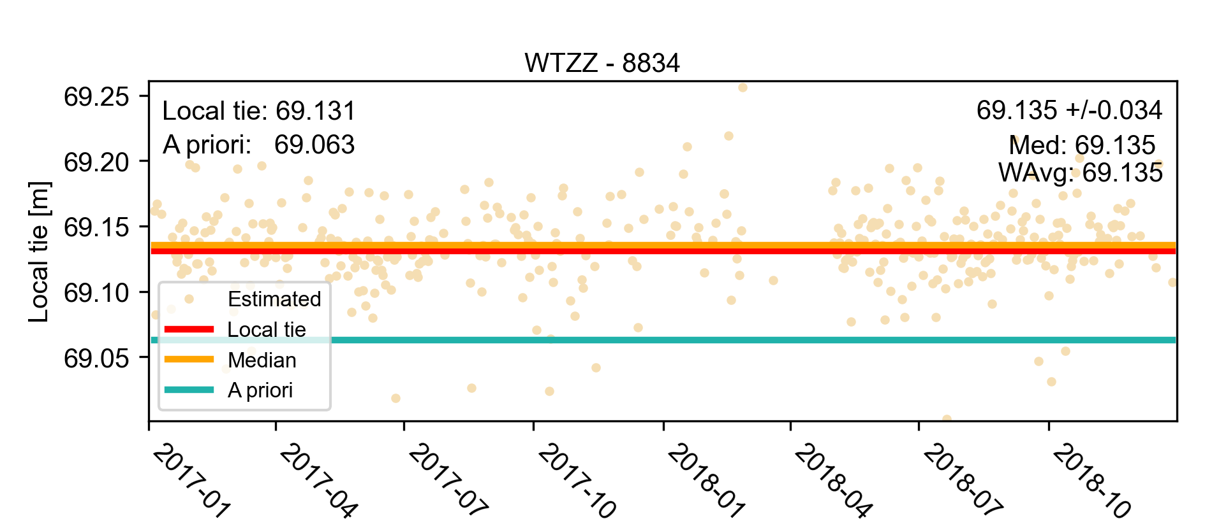
3D local tie (2/2)
Local tie
GNSS station
SLR station
Local tie calculated based on GNSS and SLR observations
Local ground measurements
GNSS-SLR stations distance based on the a priori ITRF2014/SLRF2014
Strength of the 1-day connection: 40-50 mm
Long-term agreement: 3-4 mm

Slide 11
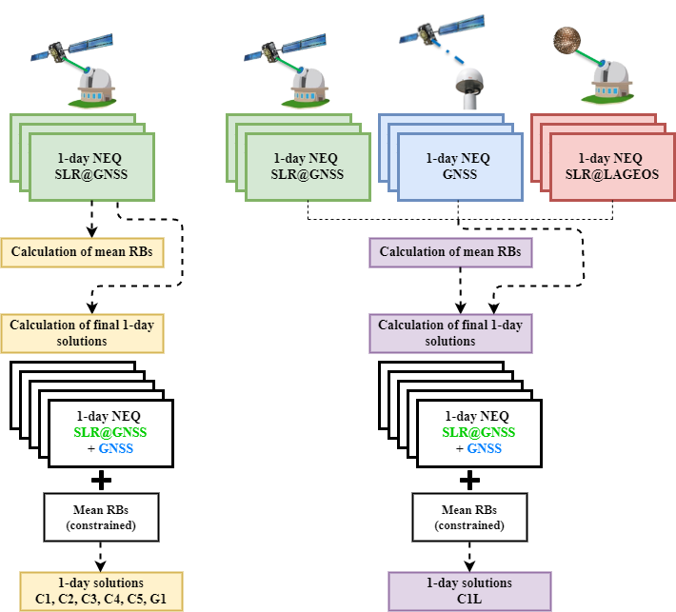
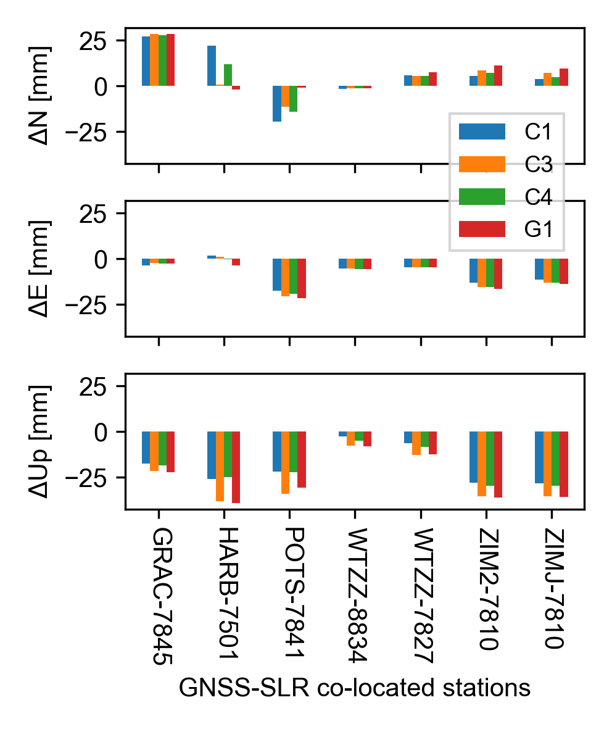
Difference between space and local ties

Slide 12
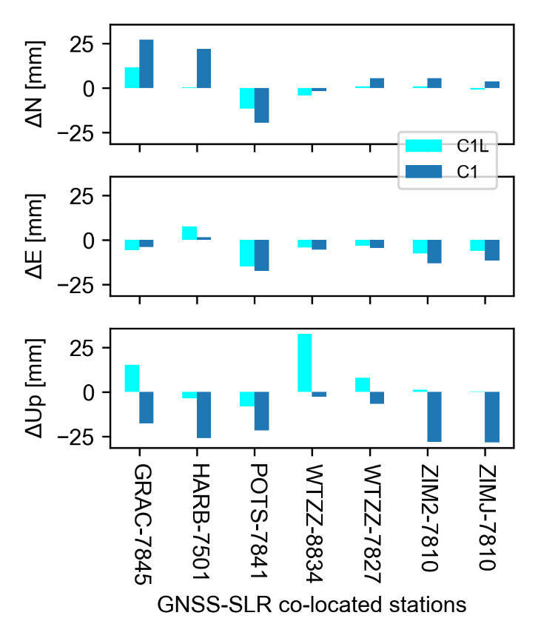
Difference between space and local ties

Slide 13
Summary
The best strategy for the datum realization aiming is consistent imposing of NNT+NNR constraints on GNSS and SLR sites
The strength of the connection onboard GNSS satellites is 40–50 mm for the1-day solutions for individual stations, whereas the mean values based on long time series agree to 3–4 mm with local tie measurements.
SLR range biases considering the LAGEOS-based station coordinates improve the consistency with the in situ local ties (Up).

Slide 14



Thank you for your attention
Dr Grzegorz Bury
grzegorz.bury@upwr.edu.pl
Find more details in:
Bury G, Sośnica K, Zajdel R, Strugarek D, Hugentobler U (2021) Determination of precise Galileo orbits using combined GNSS and SLR observations. GPS Solut 25(1):11. https://doi.org/10.1007/s10291-020-01045-3
Bury G, Sośnica K, Zajdel R, Strugarek D (2022) GLONASS precise orbit determination with identification of malfunctioning spacecraft. GPS Solut 26(2):36. https://doi.org/10.1007/s10291-021-01221-z
More scientific content:
https://orcid.org/0000-0002-5816-410X
Bury G, Sośnica K, Zajdel R, Strugarek D, Hugentobler U (2021) Geodetic Datum Realization Using SLR‐GNSS Co‐Location Onboard Galileo and GLONASS. JGR Solid Earth 126(10). https://doi.org/10.1029/2021JB022211
https://www.researchgate.net/profile/Grzegorz-Bury

