Slide 1
The contributions by BKG to the realization of the global geodetic reference frame
Daniela Thaller,
C. Flohrer, G. Engelhardt, A. Girdiuk, H. Hellmers, D. König, S. Modiri, S. Bachmann, W. Dick, S. Geist, M. Goltz, L. Klemm, S. Schneider-Leck, D. Ullrich

Slide 2
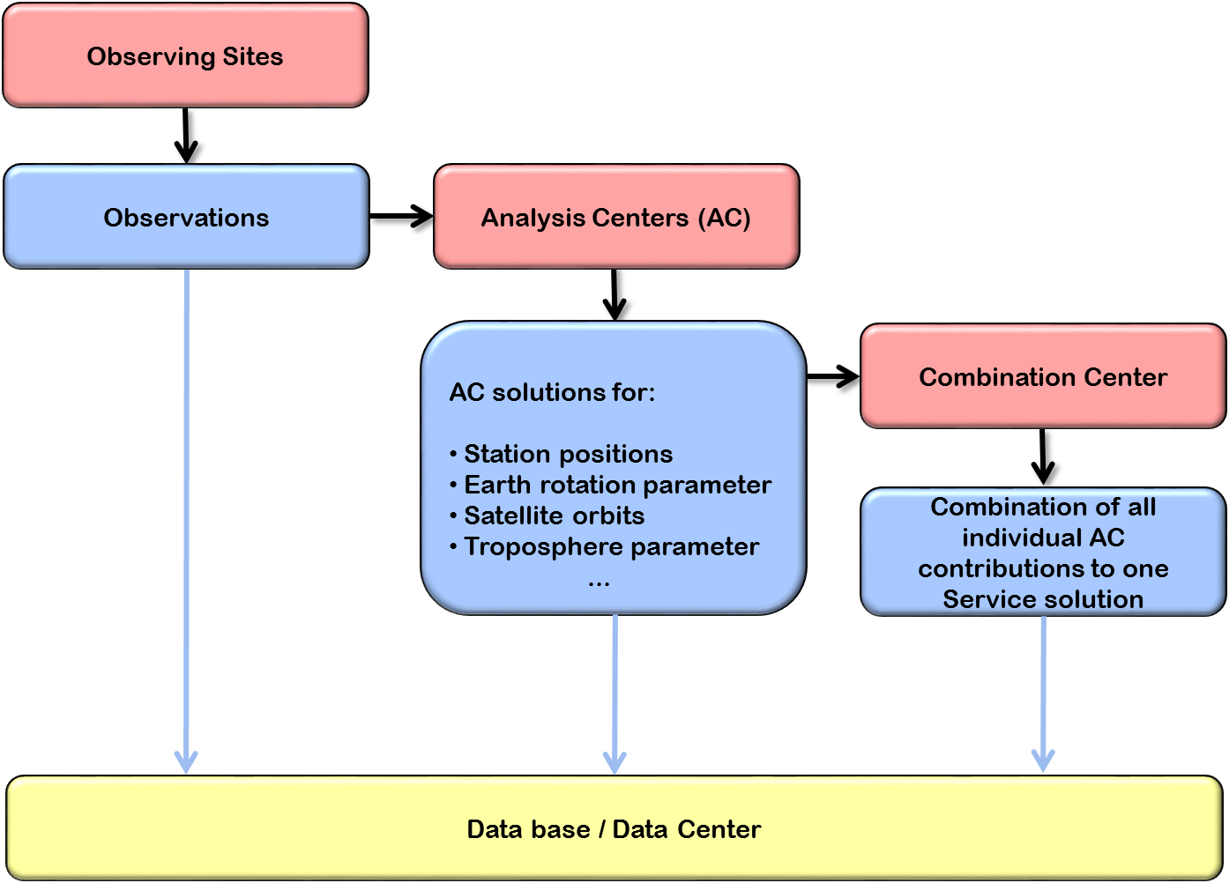
IAG Services for generating products of the GGRF: General organization

Slide 3


IAG Services for generating products of the GGRF: Our contributions
IVS + ILRS
IVS
IVS

Slide 4
IAG Services for generating products of the GGRF: Our contributions
IVS + ILRS
IVS
IVS

Slide 5
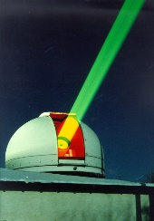

ILRS Analysis Center
ILRS Analysis Center using the Bernese GNSS Software (SLR development version)
2 operational products are generated based on 7-day arcs of LAGEOS, LAGEOS-2, Etalon-1/-2

Slide 6
ILRS Analysis Center
ILRS Analysis Center using the Bernese GNSS Software (SLR development version)
2 operational products are generated based on 7-day arcs of LAGEOS, LAGEOS-2, Etalon-1/-2
Sun
Mon
Tue
Wed
Thu
Fr
Sat
Sun
Mon
Tue
Wed
Thu
Fr
Sat
Sun
DAILY n
DAILY n+1
DAILY n+2
DAILY n+3
DAILY n+4
DAILY n+5
DAILY n+6
= Time of Data Processing
DAILY n+7
DAILY n+8

Slide 7
ILRS Analysis Center
ILRS Analysis Center using the Bernese GNSS Software (SLR development version)
2 operational products are generated based on 7-day arcs of LAGEOS, LAGEOS-2, Etalon-1/-2
Sun
Mon
Tue
Wed
Thu
Fr
Sat
Sun
Mon
Tue
Wed
Thu
Fr
Sat
Sun
DAILY n
DAILY n+1
DAILY n+2
DAILY n+3
DAILY n+4
DAILY n+5
DAILY n+6
= Time of Data Processing
DAILY n+7
DAILY n+8
…
WEEKLY n+1
WEEKLY n
Sun
Mon
Tue
Wed
Thu
Fr
Sat
Sun
Mon
Tue
Wed
Thu
Fr
Sat
Sun

Slide 8
ILRS Analysis Center
In 2020/2021 full re-processing of SLR data for the years 1993-2020 as input to ITRF2020
Parameters in operational and re-processed solutions:
  Station coordinates
  Earth Rotation Parameters: Polar motion, LOD, dUT1 (internal)
  Satellite orbits
  Range Biases
  Geocenter coordinates (internal only)
Current developments / next steps:
  Inclusion of other spherical satellites
  Set-up optimized SLR solution for combination with GNSS and VLBI
  Build a validation and feedback loop für Wettzell SLR stations (to be extendend with AGGO…)

Slide 9
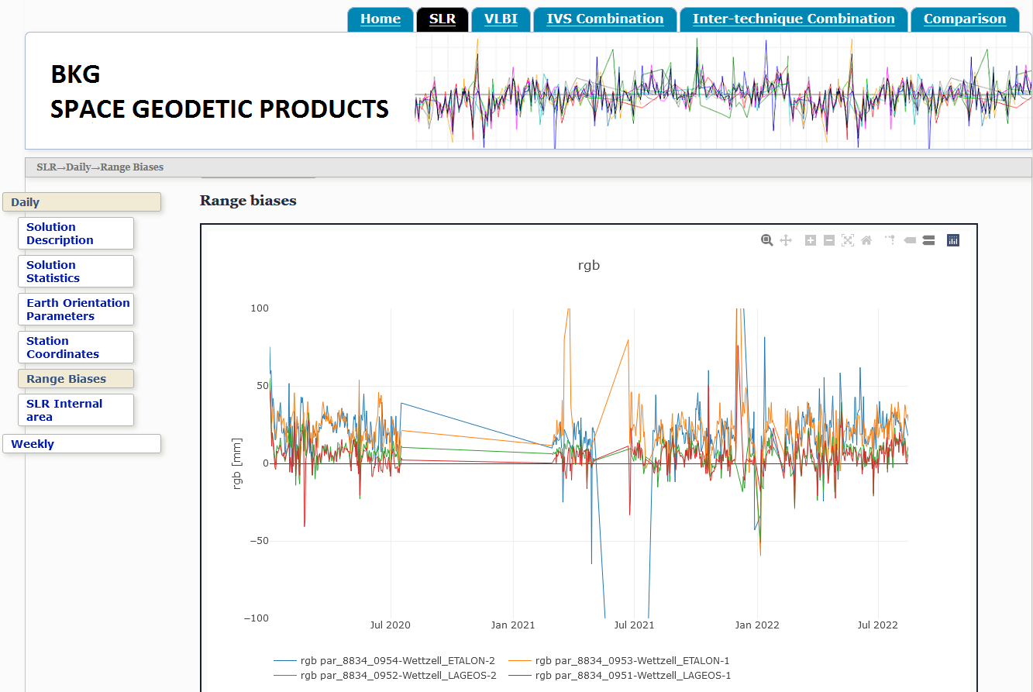
ILRS Analysis Center
Build website for presenting and monitoring our space geodetic analysis and combination products
Status: internally available for SLR analysis results
To be extended for VLBI and combined products

Slide 10
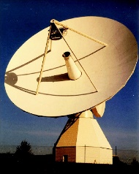
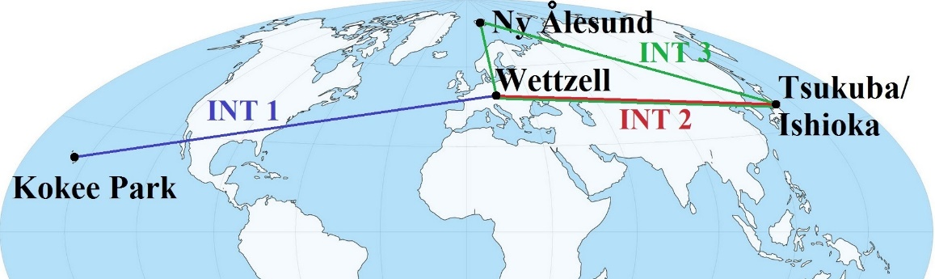
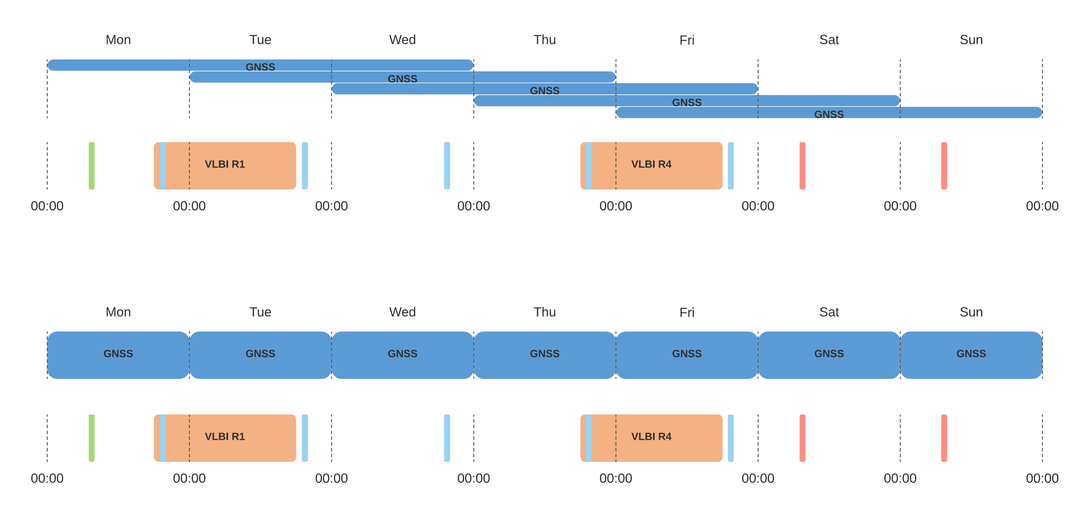
IVS Analysis Center
VLBI analysis using nySolve and CALC/Solve software
Processing of all session types:
  All 24-hour sessions (latency 10-14 days for R1/R4)
  All 1-hour Intensive sessions (latency 1-2 days)
Mon
Tue
Wed
Thu
Fr
Sat
Sun

Slide 11
IVS Analysis Center
VLBI analysis using nySolve and CALC/Solve software
Processing of all session types:
  All 24-hour sessions (latency 10-14 days for R1/R4)
  All 1-hour Intensive sessions (latency 1-2 days)
In 2020/2021 full re-processing of VLBI data for the years 1984-2020 as input to ITRF2020
Parameters:
Mon
Tue
Wed
Thu
Fr
Sat
Sun
Session | Station coord. | dUT1 | Polar motion | LOD | Nutation | Radio sources | Troposphere
24-hour | X | X | X | X | X | X | X
1-h INT |  | X |  |  |  |  | X

Slide 12
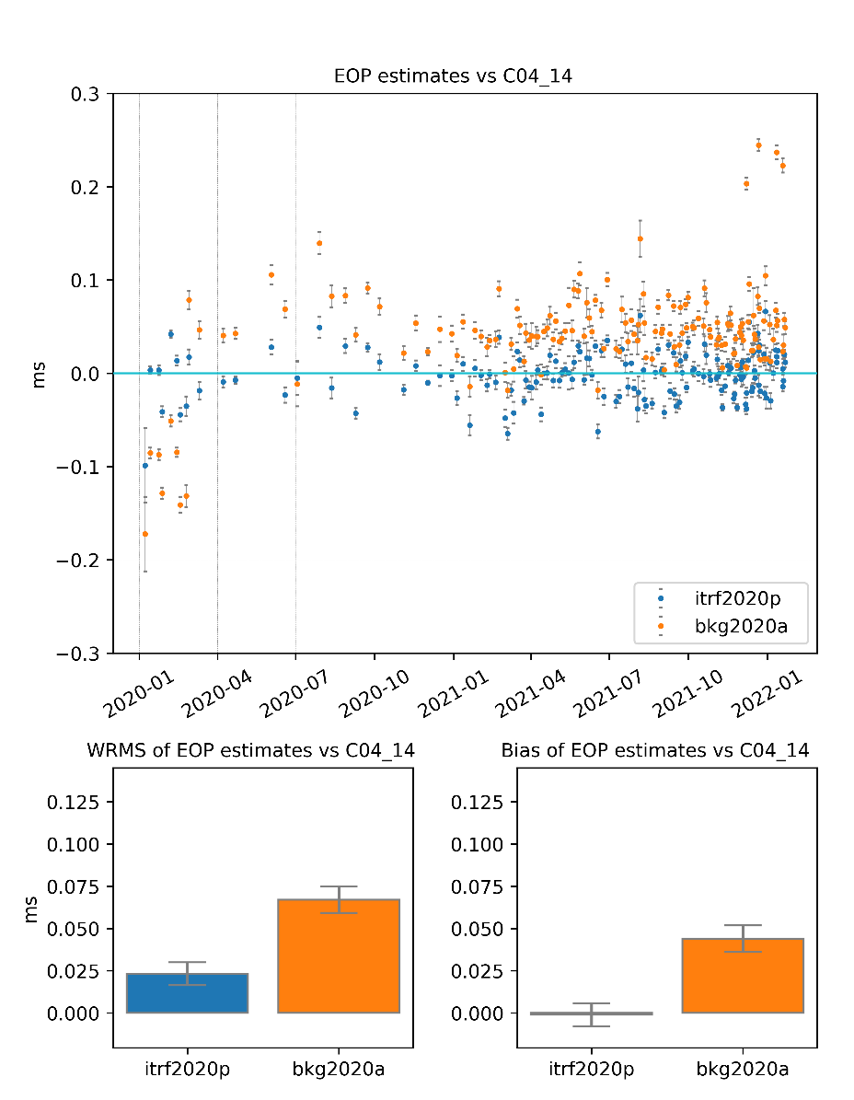
IVS Analysis Center
Highlights of the recent years:
Convertion of all available VLBI data (from 1984) to the VGOSDb format, their processing, check of the backwards compatibility
Processing of the VGOS Sessions and preparing the internal a priori for the VGOS antennas (routine processing before ITRF2020)
Current tasks
Implementation of the ITRF2020: dUT1 variations (derived from VGOS Intensives) are improved by the updated station coordinates
Establish broad automated solution quality control (EOP, Helmert parameters, comparisons with other solutions)

Slide 13
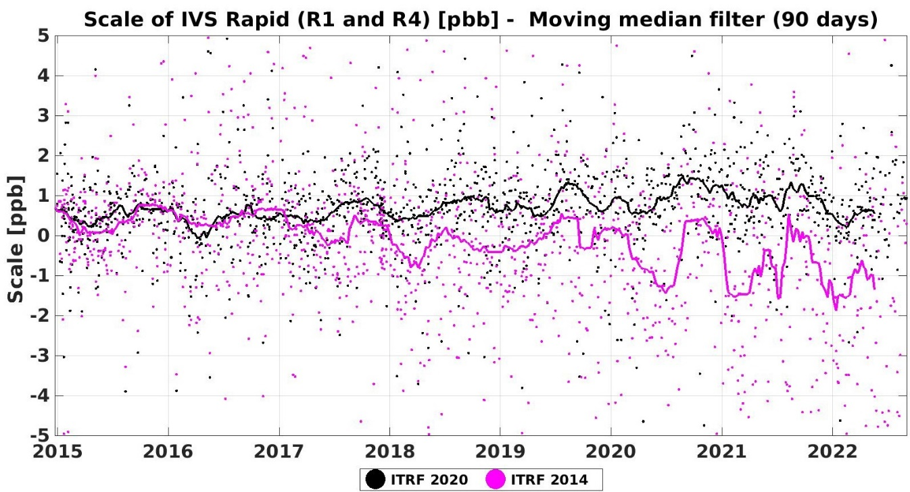
IVS Combination Centre
BKG is operating the IVS Combination Centre in cooperation with DGFI-TUM
R1-/R4-sessions by the individual IVS Analysis Centres (ACs) are compared, validated and combined on a regular basis
All other 24-h sessions are combined irregularily (usually along with generation of quarterly VTRF)
Highlights of the recent years:
Implementation of improved combination procedure
Preparation of IVS combined contribution to ITRF2020
Current tasks:
  Evaluations along with ITRF2020 (e.g. scale)
  Evaluation of VGOS stations/sessions
Future work:
  Handling of source positions in the combination
  Combination of IVS intensive sessions

Slide 14
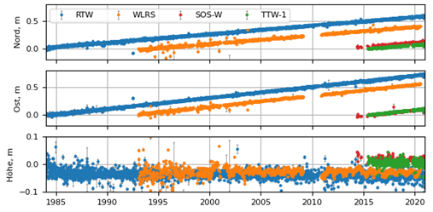
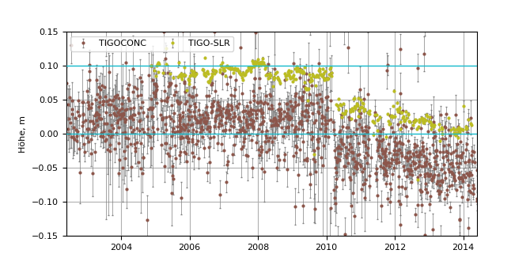
BKG‘s Contributions to ITRF2020: Inter-comparisons
Comparison of station coordinate time series from re-processed solutions for co-location sites:
Wettzell (2x VLBI, 2x SLR)
TIGO (VLBI, SLR)

Slide 15
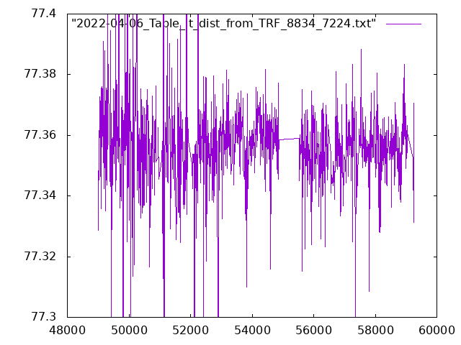
BKG‘s Contributions to ITRF2020: Inter-comparisons
Station co-location | Origin of LT value | Local Tie value
RTW - TTW1 | BKG-MC 2020 | 123.309 m +- 3.3 mm (343)
 | Terr. | 123.307 m +- 0.8 mm
RTW - WLRS | BKG-MC 2020 | 77.357 m +-10.0 mm (1142)
 | Terr. | 77.358 m +- 0.8 mm
RTW - SOSW | BKG-MC 2020 | 48.192 m +- 6.4 mm (211)
 | Terr. | 48.191 m +- 0.6 mm
TTW1 - WLRS | BKG-MC 2020 | 61.014 m +- 9.8 mm (185)
 | Terr. | 61.010 m +- 0.7 mm
TTW1 – SOSW | BKG-MC 2020 | 118.285 m +-10.1 mm (163)
 | Terr. | 118.283 m +- 0.7 mm
SOSW – WLRS | BKG-MC 2020 | 58.445 m +- 5.9 mm (185)
 | Terr. | 58.445 m +- 0.7 mm
Derive „weekly Local Ties“ for monitoring the stability of co-location sites
Derived „mean Local Ties“ for Wettzell agree with terrestrial measurements at mm-level

Slide 16
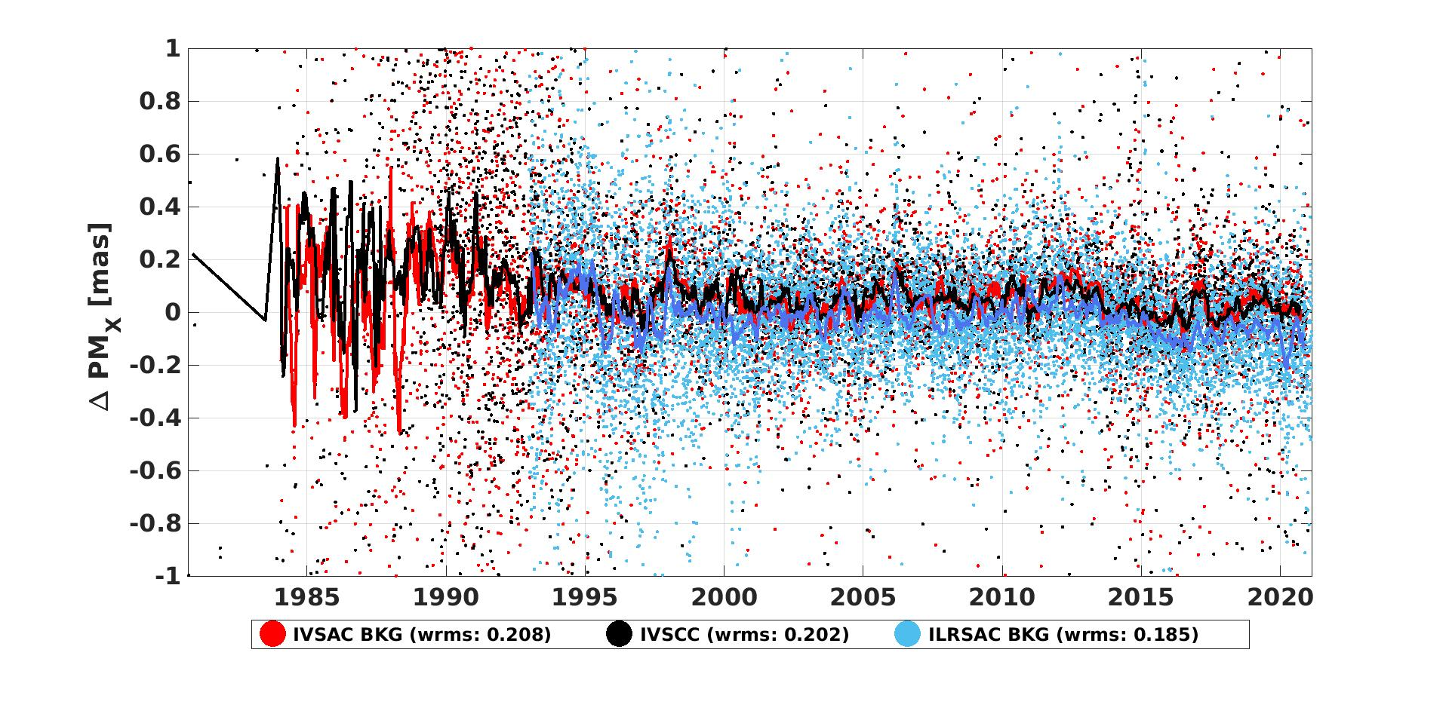
BKG‘s Contributions to ITRF2020: Inter-comparisons
Agreement of polar motion between VLBI and SLR solutions reprocessed for ITRF2020

Slide 17
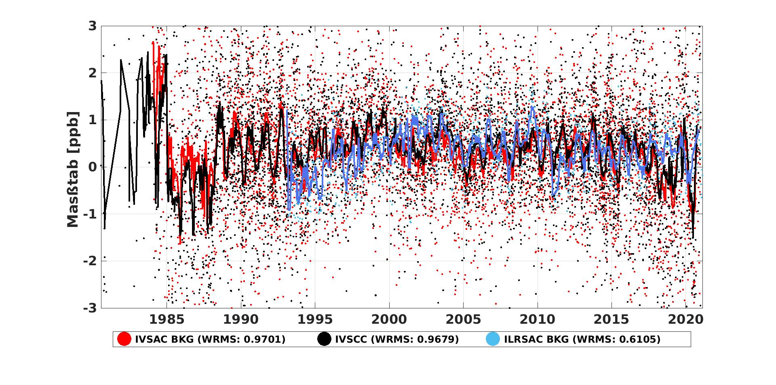
BKG‘s Contributions to ITRF2020: Inter-comparisons
Agreement of Scale between VLBI and SLR solutions reprocessed for ITRF2020

Slide 18
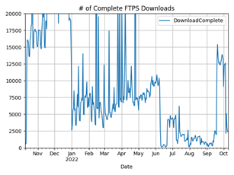
IVS Data Center
BKG operates one of the 3 global IVS Data Centers
Regular mirroring procedure several times per day
Provide public access to all IVS data and products for the community („open data“ policy)
Recent changes:
  New validation procedures for uploaded files
  Switch from FTP to FTPS and HTTPS in 2022
In development:
  automated notifications for institutions uploading files
  evaluate necessity of a whitelist for users

Slide 19
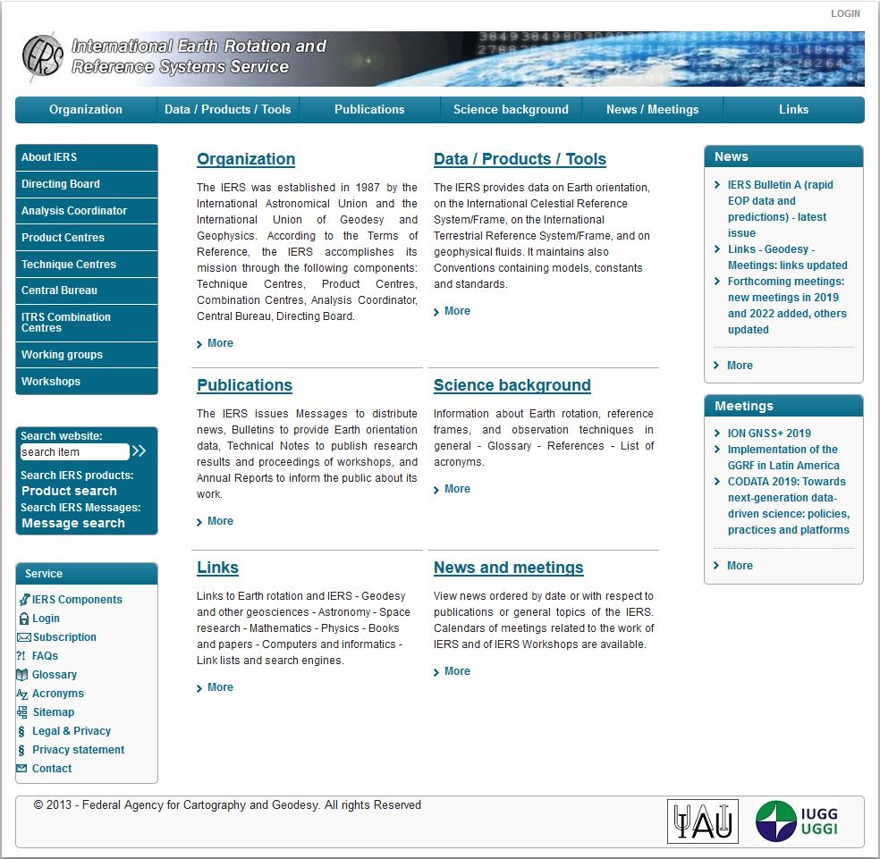
IERS Central Bureau
IERS Central Bureau at BKG maintains the IERS website
https://www.iers.org
= Access point for all data, products, and publications of the IERS

Slide 20
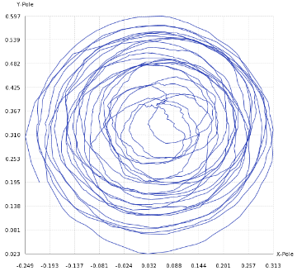
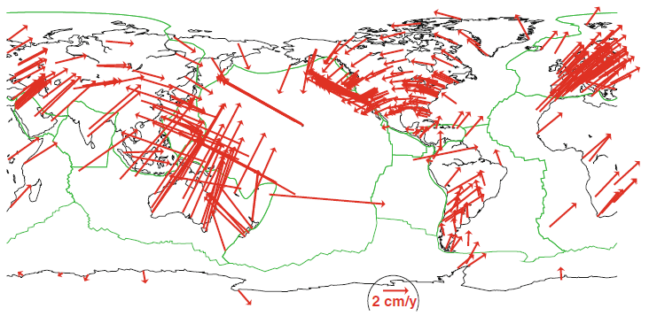
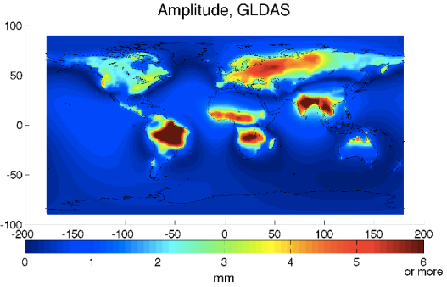
IERS Central Bureau
https://www.iers.org
Earth Orientation
Parameters
Terrestrial and Celestial Reference Frame
Geophysical
models for loading

Slide 21
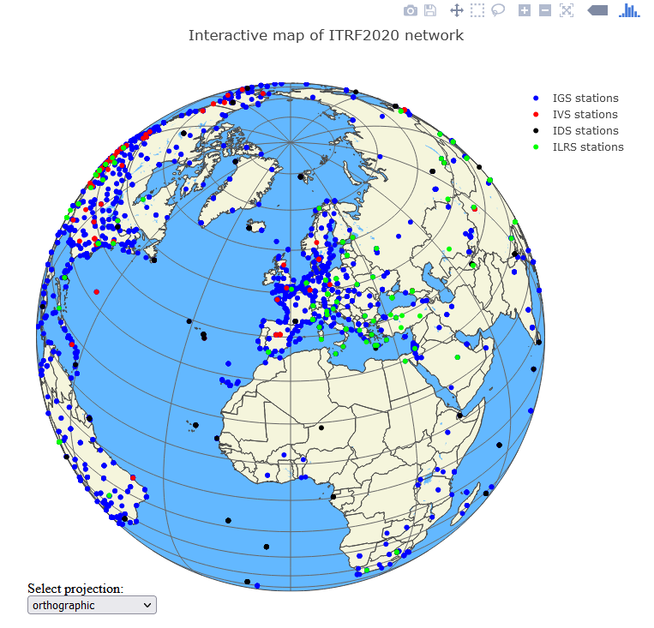
IERS Central Bureau
Supporting ITRF2020 generation process in manifold way:
Organisation of discussions within IERS on ITRF2020 preparation
Distribution of Call for local survey results
Collection of input data for ITRF2020 and providing them to ITRS Combination Centres
Storing ITRF2020 data in IERS data archive
Providing information on ITRF2020 to users via IERS Message and IERS web site, including an interactive map of ITRF stations
Planned: publication of two IERS Technical Notes on ITRF2020

Slide 22
Summary and Outlook
Summary:
BKG is contributing to operational product generation of VLBI and SLR data
BKG is running data centers for VLBI and IERS
ITRF2020 was a big topic in the past two years:
  Re-processing of VLBI and SLR
  Generating the combined VLBI contribution
  Data archive for technique-specific input SINEX
Outlook:
Establish an operational combined product -> presentation by Lisa Klemm
Establish a common website to present and access all our data analysis and combination products
Establish a quality management according to ISO for all operational activities at BKG

Slide 23
Thanks for your attention!
Bundesamt für Kartographie und Geodäsie
Referat G1 “Grundsatz, Kombination Raumverfahren”
Richard-Strauss-Allee 11
60598 Frankfurt am Main
Dr. Daniela Thaller
daniela.thaller@bkg.bund.de
www.bkg.bund.de
Phone +49 69 6333 - 273

Slide 24
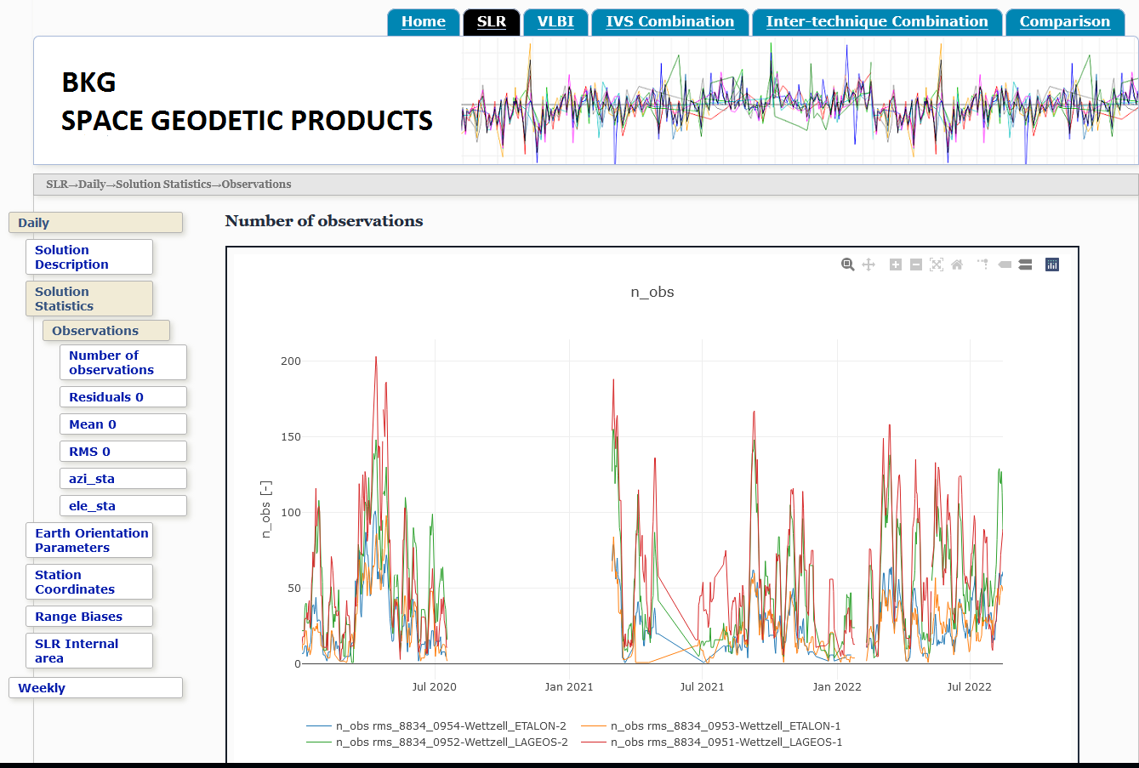
ILRS Analysis Center
Build website for presenting and monitoring SLR analysis results
To be extended by other space geodetic analysis and combination products

Slide 25
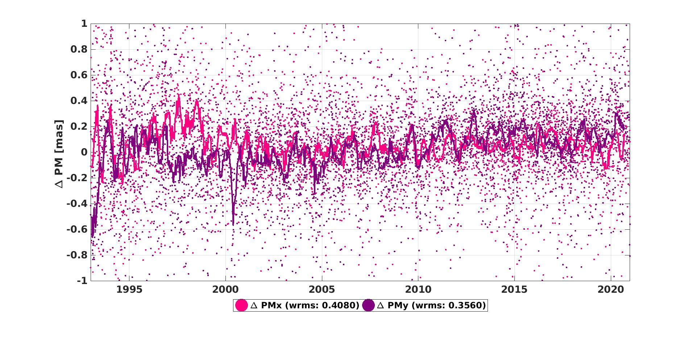
BKG‘s Contributions to ITRF2020: Inter-comparisons
Agreement of polar motion between VLBI and SLR solutions reprocessed for ITRF2020

Slide 26
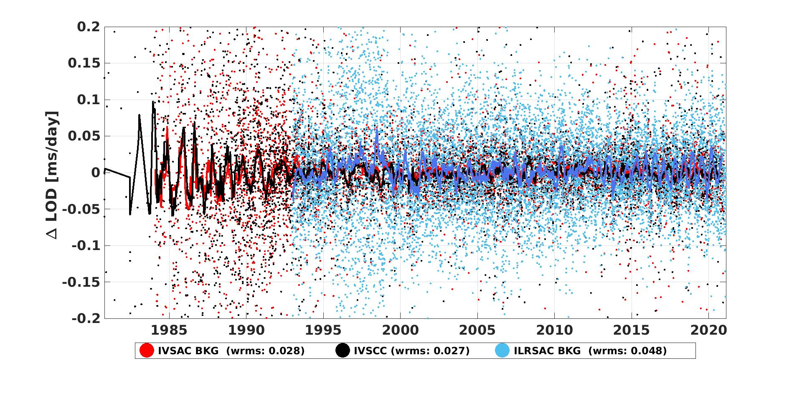
BKG‘s Contributions to ITRF2020: Inter-comparisons
Agreement of LOD between VLBI and SLR solutions reprocessed for ITRF2020

Slide 27
Quality management
BKG is establishing an ISO-certificated Quality Management for all processes monitored by key numbers
  ILRS analysis:
    Latency of DAILY and WEEKLY products (do we meet the deadlines?)
    Aposteriori RMS of SLR solutions
  IVS analysis:
    dUT1: RMS of differences w.r.t. IERS C04 / Bulletin A for R1/R4 and INT sessions
  IVS Combination:
    dUT1: RMS of differences w.r.t. IERS C04 / Bulletin A for R1/R4 and Quarterly combination
  IVS Data Center:
    Completeness of data set
  IERS Central Bureau:
    Completeness of data set
    Uptime of web services

