Slide 1


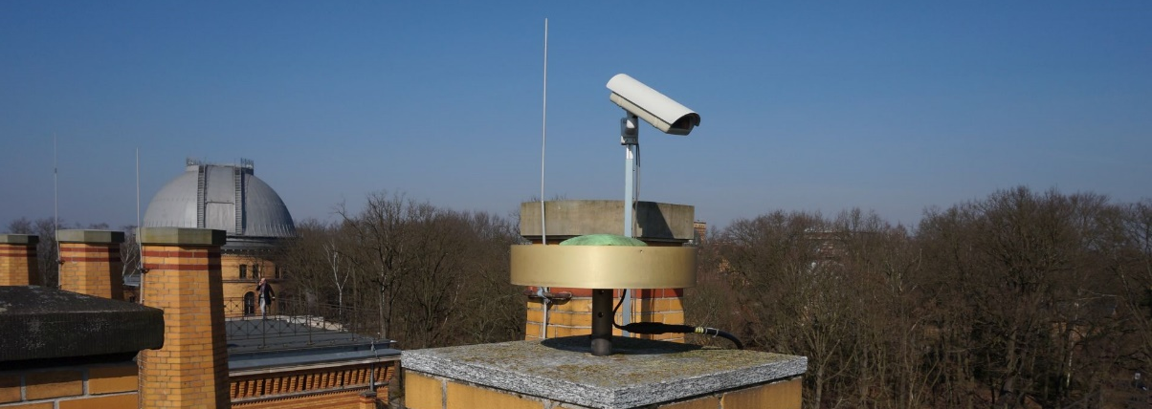

The impact of non-tidal surface loading deformation on GNSS coordinate time series
B. Männel¹, S. Glaser¹, A. Brandt¹, and H. Schuh^{1,2}
¹ German Research Centre for Geosciences, Potsdam
² Technische Universität Berlin

Slide 2
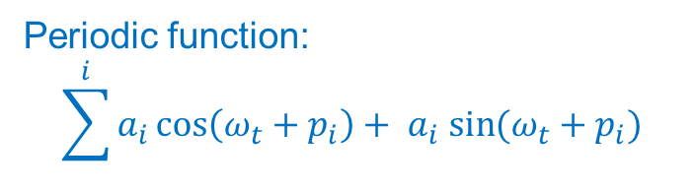
Introduction
ITRF2020
Non-tidal loading models (ESMGFZ)
GFZ repro3 solution
Comparison of annual & semiannual amplitude and phase
Reduction of RMS (linear trajectory model), Reduction of periodic signals
Periodic signals vs. NTL models
Correction at solution level
Correction at observation level
Periodic function:
$$\sum^{i}{a_{i}\cos\left(ω_{t}+p_{i}\right)+ a_{i} sin⁡(ω_{t}+p_{i})}$$

Slide 3
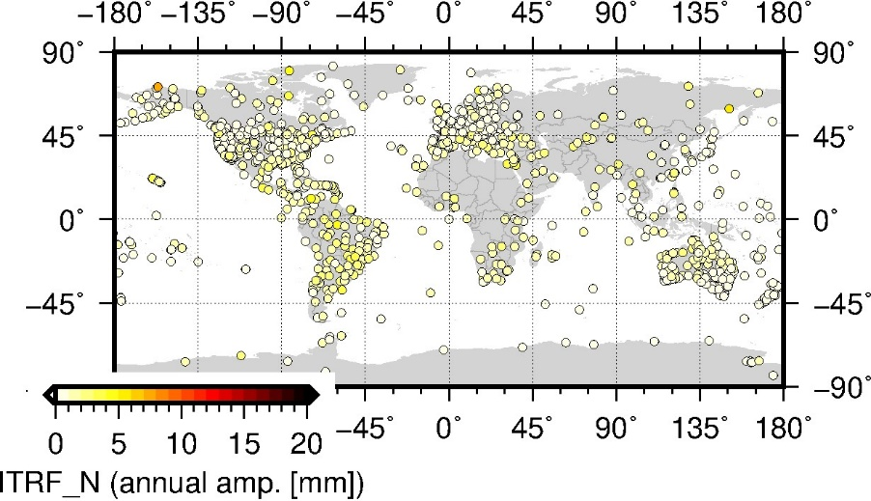
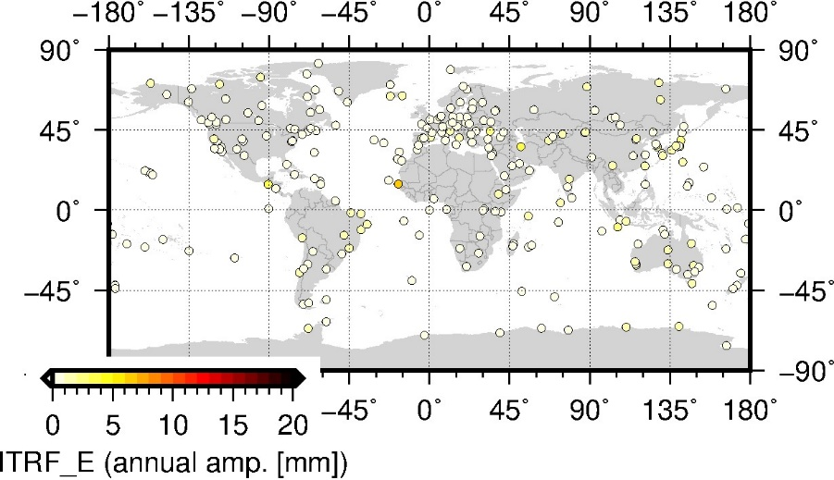
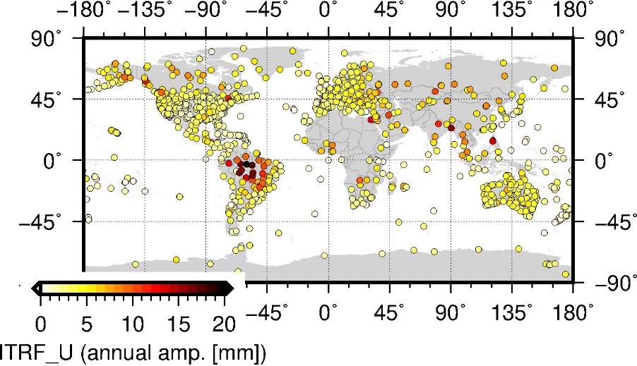
Periodic signals in ITRF2020
ITRF2020 periodic signals → CF frame
Annual & semiannual signals
available via https://itrf.ign.fr/en/solutions/ITRF2020

Slide 4
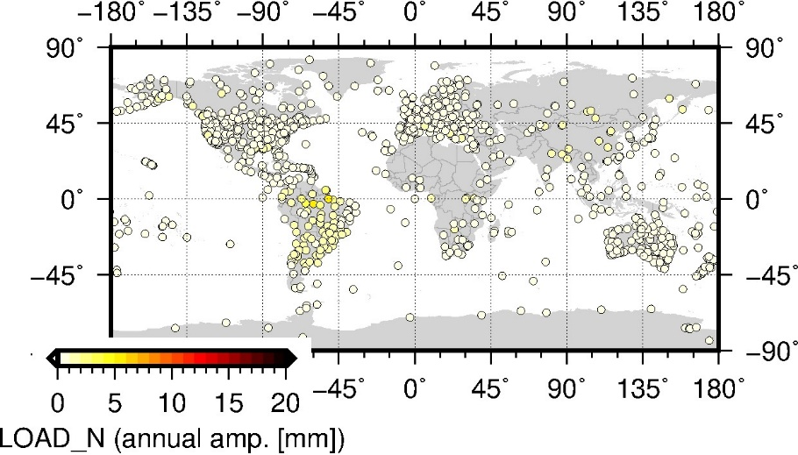
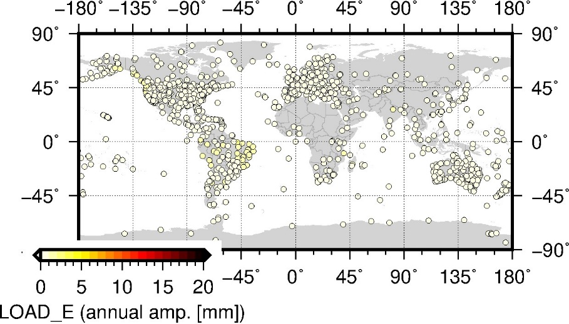
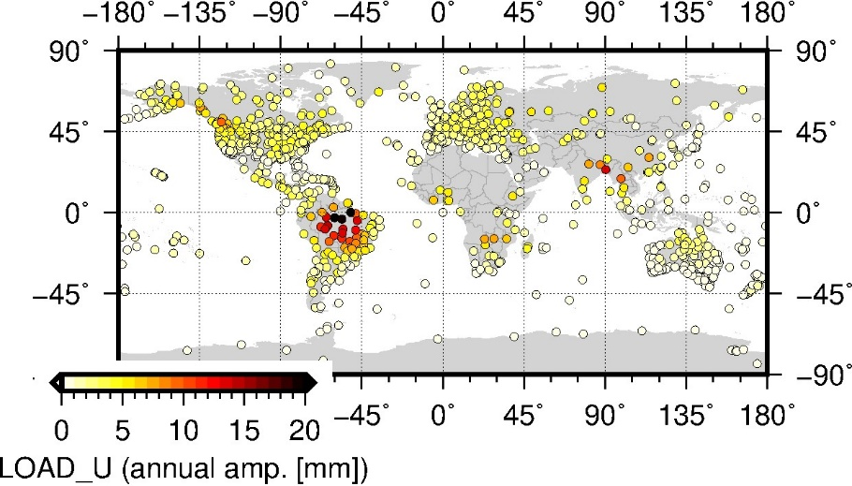
Non-tidal loading models
ESMGFZ models (components NTAL, NTOL, HYDL, SLEL) → CF frame → time series analysis
Computed for all ITRF2020 GNSS stations
spatial resolution 0.5°, temporal 3h or 24h
available via isdc.gfz-potsdam.de/esmdata/loading/

Slide 5
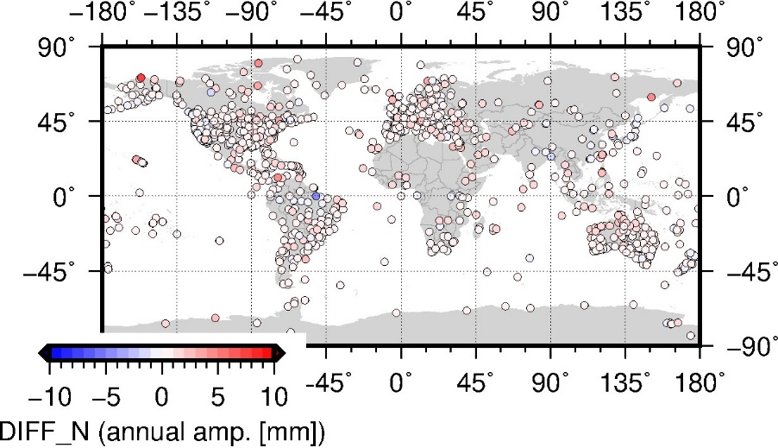
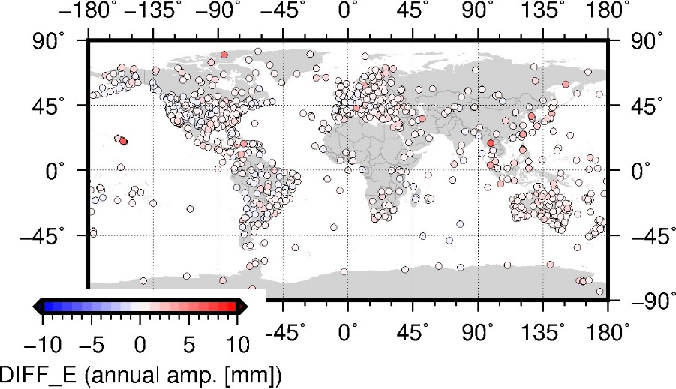
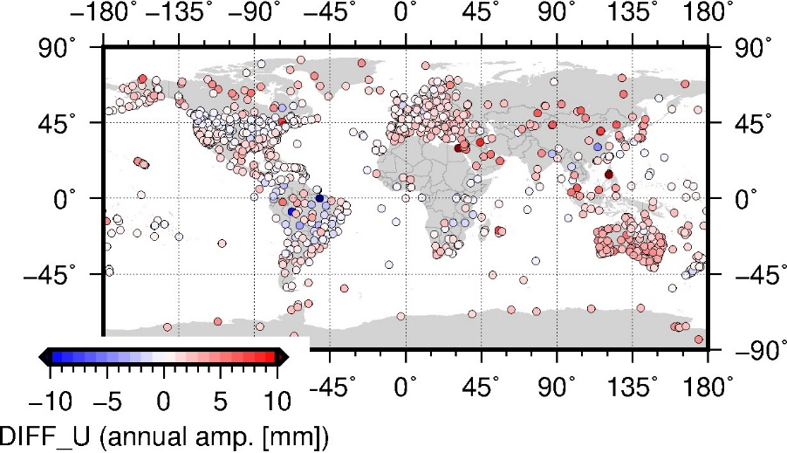
Comparison ITRF2020 - ESMGFZ
Difference ITRF2020 – ESMGFZ between the annual amplitudes
Red = ITRF2020 signal is larger, blue = ESMGFZ signal is larger

Slide 6
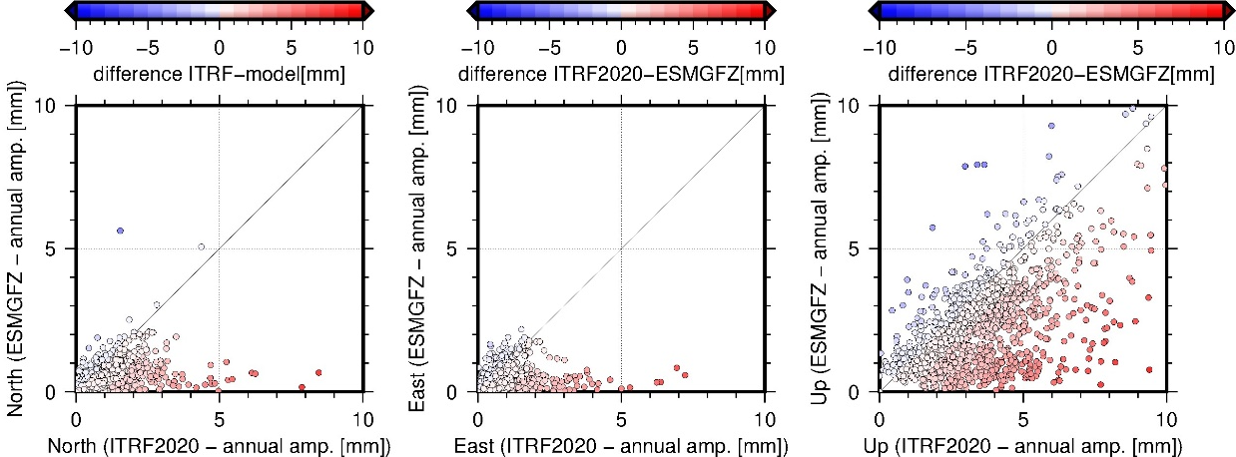
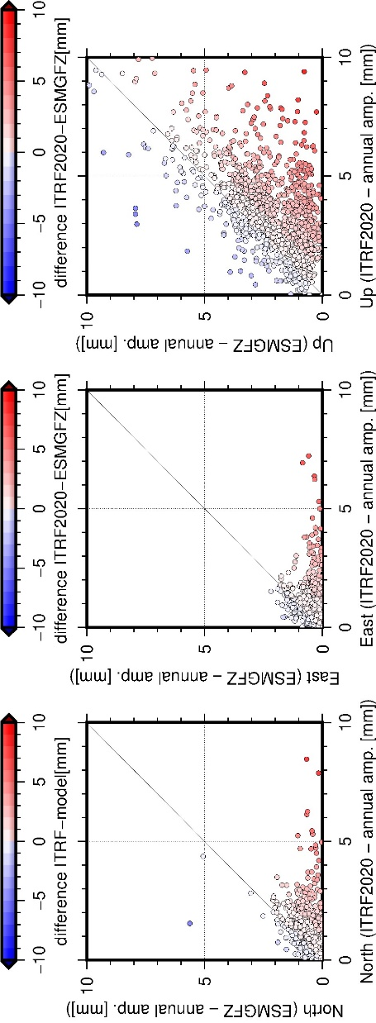
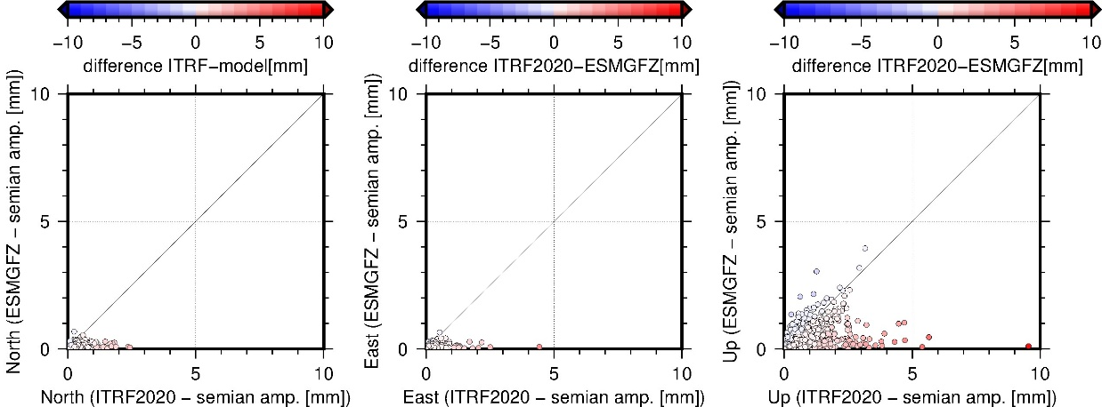
Comparison ITRF2020 - ESMGFZ
Red = ITRF2020 signal is larger, blue = ESMGFZ signal is larger
Expectation: ITRF2020 signals are larger than ESMGFZ

Slide 7
Comparison ITRF2020 - ESMGFZ
Red = ITRF2020 signal is larger, blue = ESMGFZ signal is larger
Expectation: ITRF2020 signals are larger than ESMGFZ

Slide 8
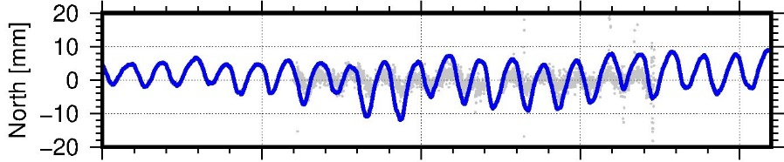
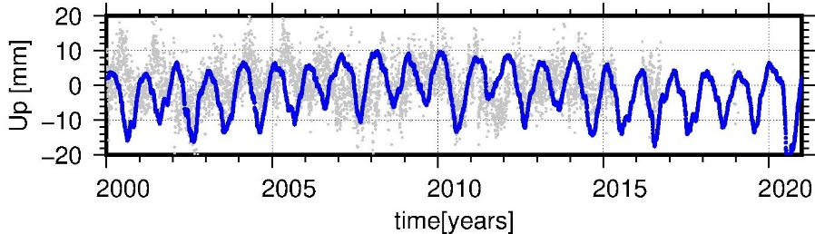
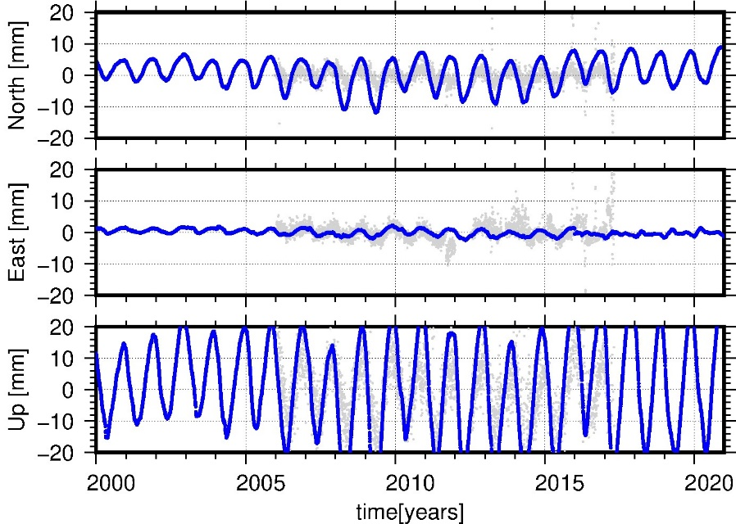
Comparison ITRF2020 - ESMGFZ
Red = ITRF2020 signal is larger, blue = ESMGFZ signal is larger
Expectation: ITRF2020 signals are larger than ESMGFZ
MAPA
WUHN
Amazonas region, Brazil
Wuhan, China

Slide 9
Introduction
ITRF2020
Non-tidal loading models (ESMGFZ)
GFZ repro3 solution
Comparison of annual & semiannual amplitude and phase
Reduction of RMS (linear trajectory model), Reduction of periodic signals
Periodic signals vs. NTL models
Correction at solution level (2000-2020)
Correction at observation level (2014-2015)
Periodic function:
$$\sum^{i}{a_{i}\cos\left(ω_{t}+p_{i}\right)+ a_{i} sin⁡(ω_{t}+p_{i})}$$

Slide 10
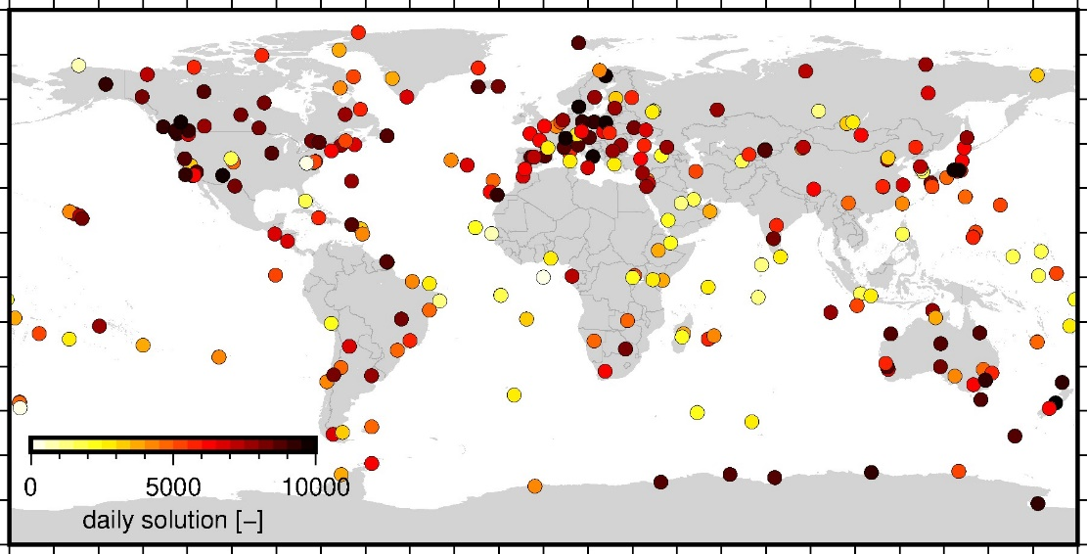
GFZ repro3 solution
Full reprocessing GPS / GLONASS / Galileo from 1994 to 2020
Satellite orbits and clocks, station coordinates, Earth rotation parameters
Products included troposphere delay and gradients, satellite attitude, biases
Statistics
Number of stations | 322
Number of satellites | 132 (G:67, R:39, E:26)
Number of daily solutions | 9962 (1994-2020) + extension for 2021-2022
Männel et al. (2021) https://doi.org/10.5880/GFZ.1.1.2021.001

Slide 11
Corrections at solution level (GFZ repro3)

Slide 12
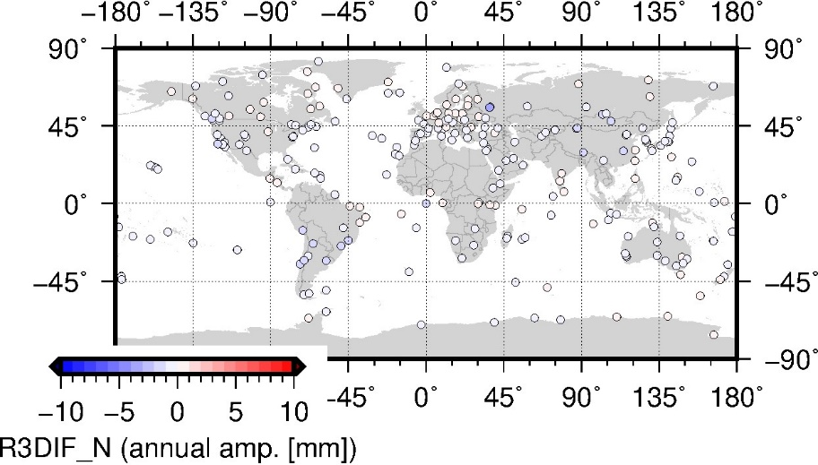
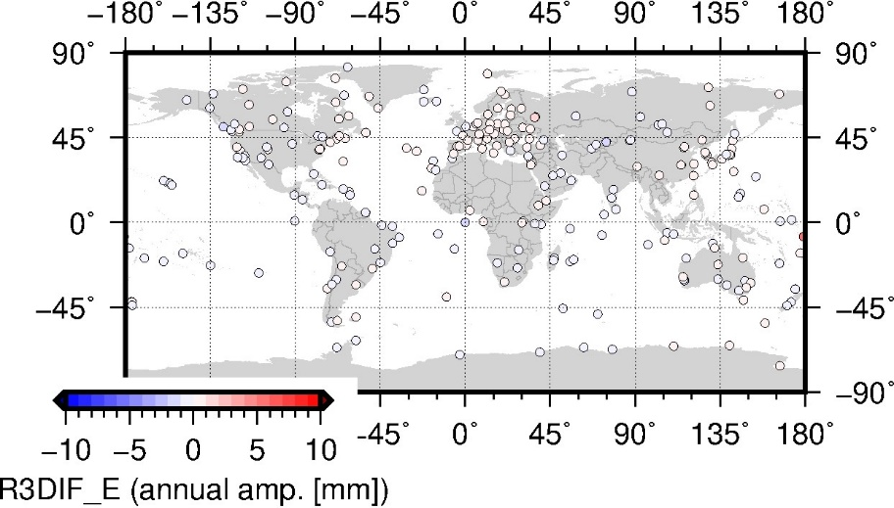
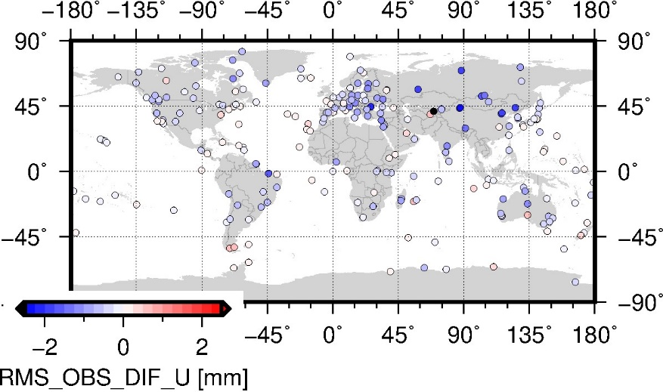
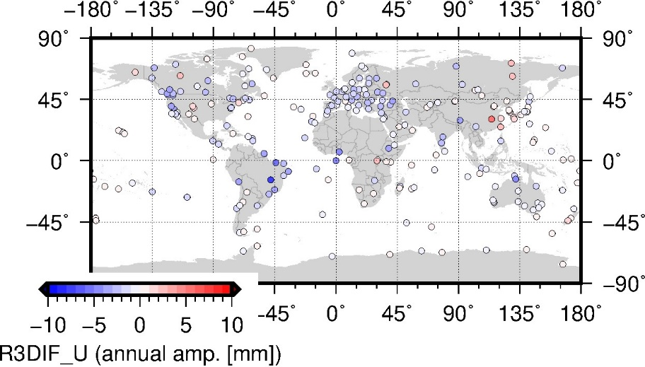
Corrections at solution level (GFZ repro3)
diff. = corrected - uncorrected
Trajectory model including periodic (seasonal) functions (only stations > 1000 daily solutions):
Annual amplitudes in height decrease 3.20 ± 0.1 → 2.61 ± 0.1 mm
Semi-annual amplitudes are reduced (in height improvement for 85% of the stations)

Slide 13



Corrections at solution level (GFZ repro3)
diff. = corrected - uncorrected
Trajectory model including periodic (seasonal) functions (only stations > 1000 daily solutions):
Semi-annual amplitudes in height decrease 0.96 ± 0.04 → 0.90 ± 0.03 mm
Semi-annual amplitudes are reduced (in height improvement for 90% of the stations)

Slide 14
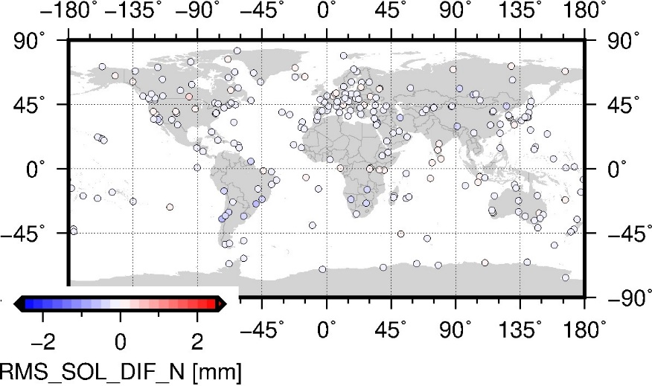
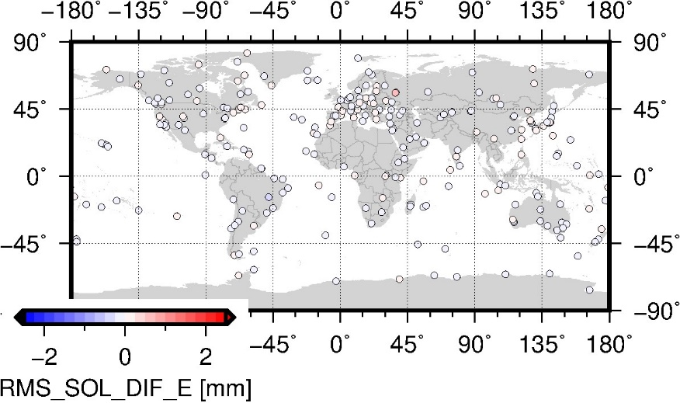
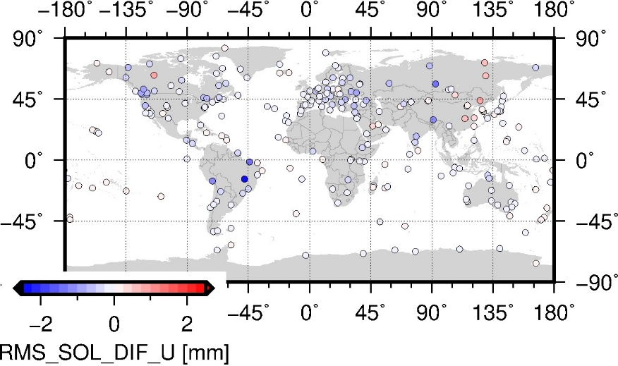
Corrections at solution level (GFZ repro3)
diff. = corrected - uncorrected
Linear trajectory model (2000-2020):
RMS reduction in North for 85%, in East for 73%, in height for 75% of the stations
Some stations show an increased RMS in the height coordinate (e.g., YELL, WUHN, YAKT …)

Slide 15
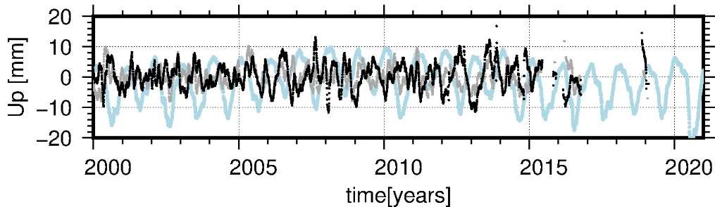
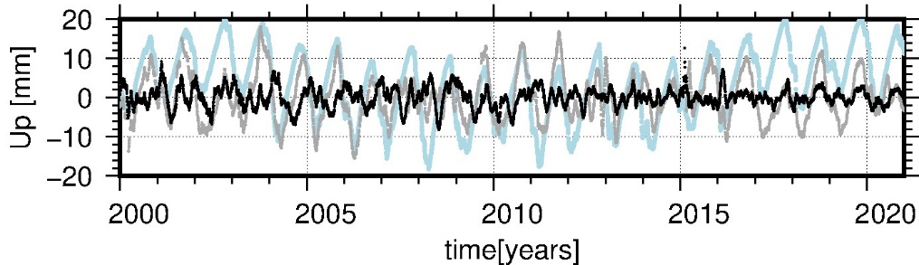
Corrections at solution level (GFZ repro3)
WUHN
BRAZ

Slide 16
Corrections at observation level (GFZ repro3)

Slide 17
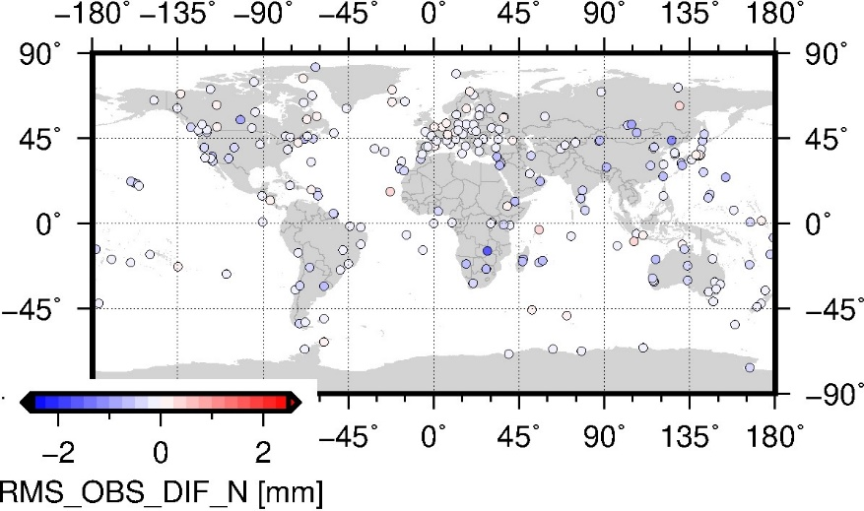
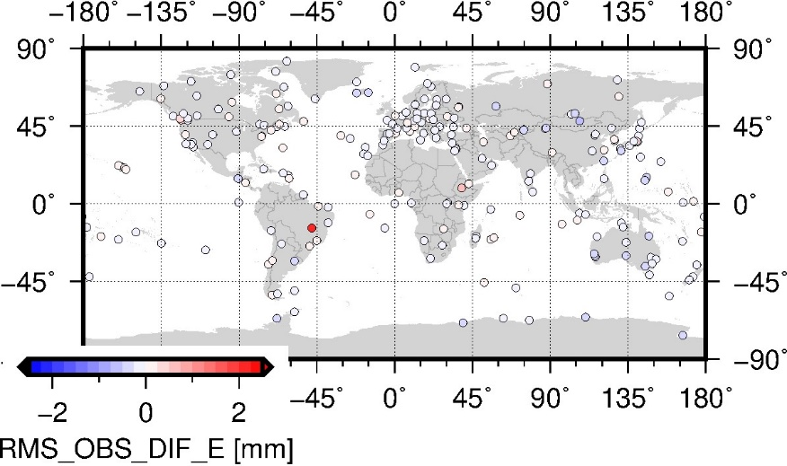
Corrections at observation level (GFZ repro3)
diff. = corrected - uncorrected
Linear trajectory model (2014-2015):
RMS reduction in North for 87%, in East for 76%, in height for 78% of the stations
Few stations show an increased RMS in the height coordinate (e.g., YELL, PARC, RIO2)

Slide 18
Summary & Conclusion
Comparison of periodic signals in ITRF2020 and seasonal signals in non-tidal loading corrections (ESMGFZ models)
  Differences of annual amplitudes max. 10 mm
  mostly ITRF2020 > ESMGFZ, few stations with some interesting characteristics
Applying non-tidal loading corrections to GFZ repro3 coordinates (solution level)
  → Reduction in annual and semi-annual signals (up to 5 mm) and coordinate RMS (up to 2.5 mm)
Applying non-tidal loading corrections at the observation level (preliminary 2014-2015)
  → Reduction coordinate RMS (up to 2.5 mm)

Slide 19
The impact of non-tidal surface loading deformation on GNSS coordinate time series
B. Männel¹, S. Glaser¹, A. Brandt¹, and H. Schuh^{1,2}
¹ German Research Centre for Geosciences, Potsdam
² Technische Universität Berlin

Slide 20
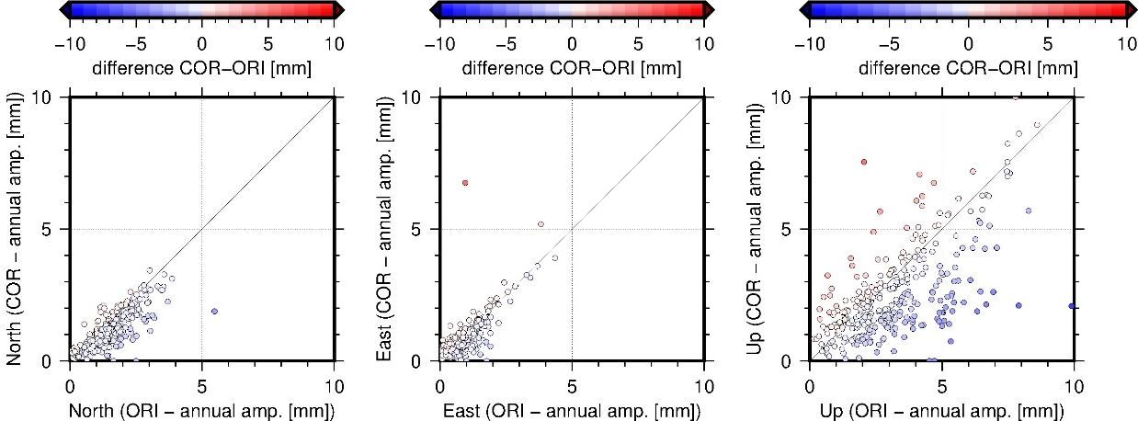
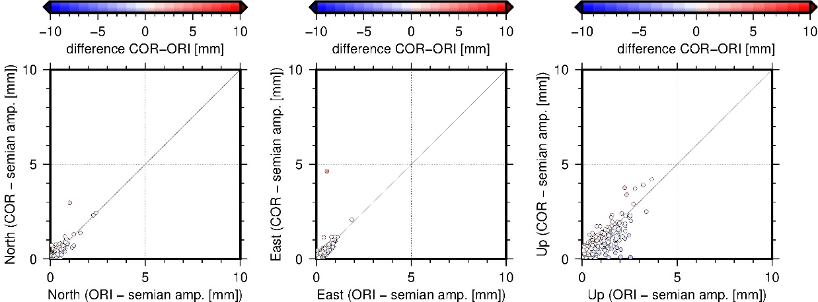
Corrections at solution level
Trajectory model including periodic (seasonal) functions:
Annual amplitude
Semi-annual

